Slide 1
Perception of risk, behavior, and COVID transmission dynamics
Sarah Nowak
December 2, 2021

Slide 2

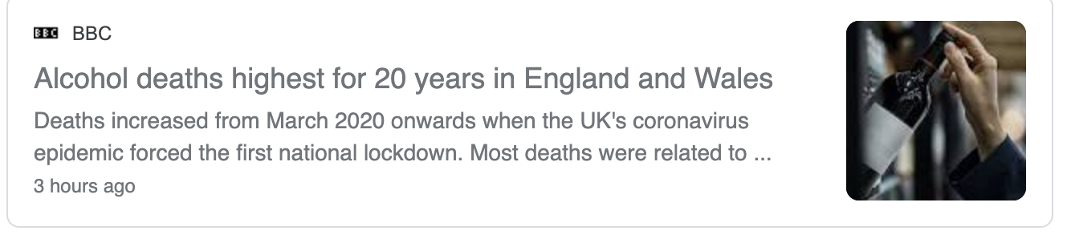
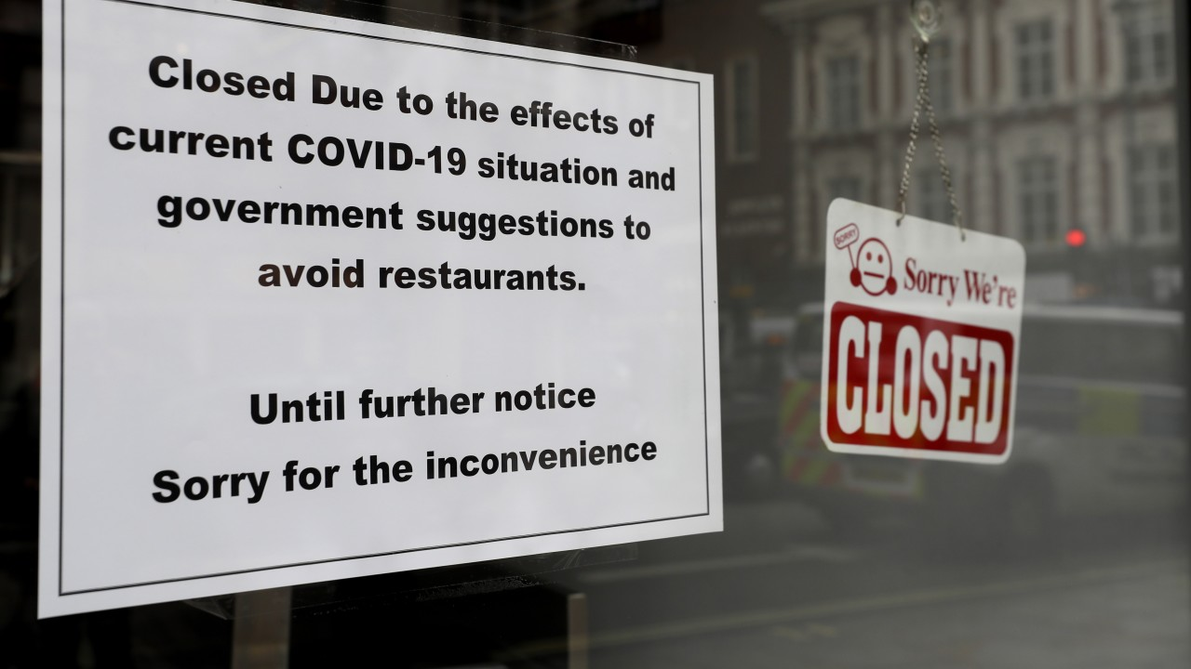
Social Distancing Measures Have Costs

Slide 3
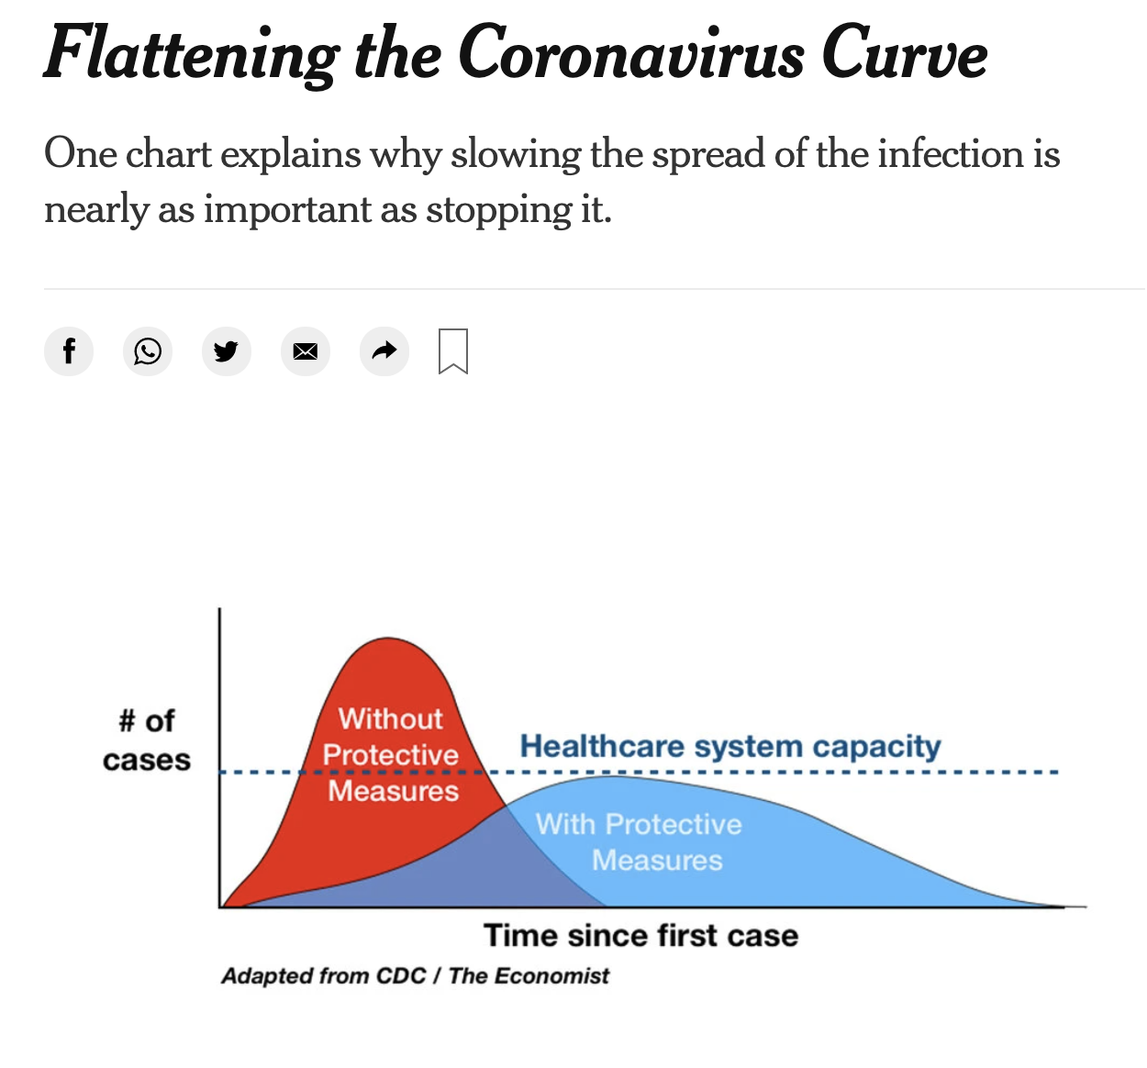
Different Policy Makers Have Different Goals With Social Distancing Measures
Mitigation
Suppression

Slide 4
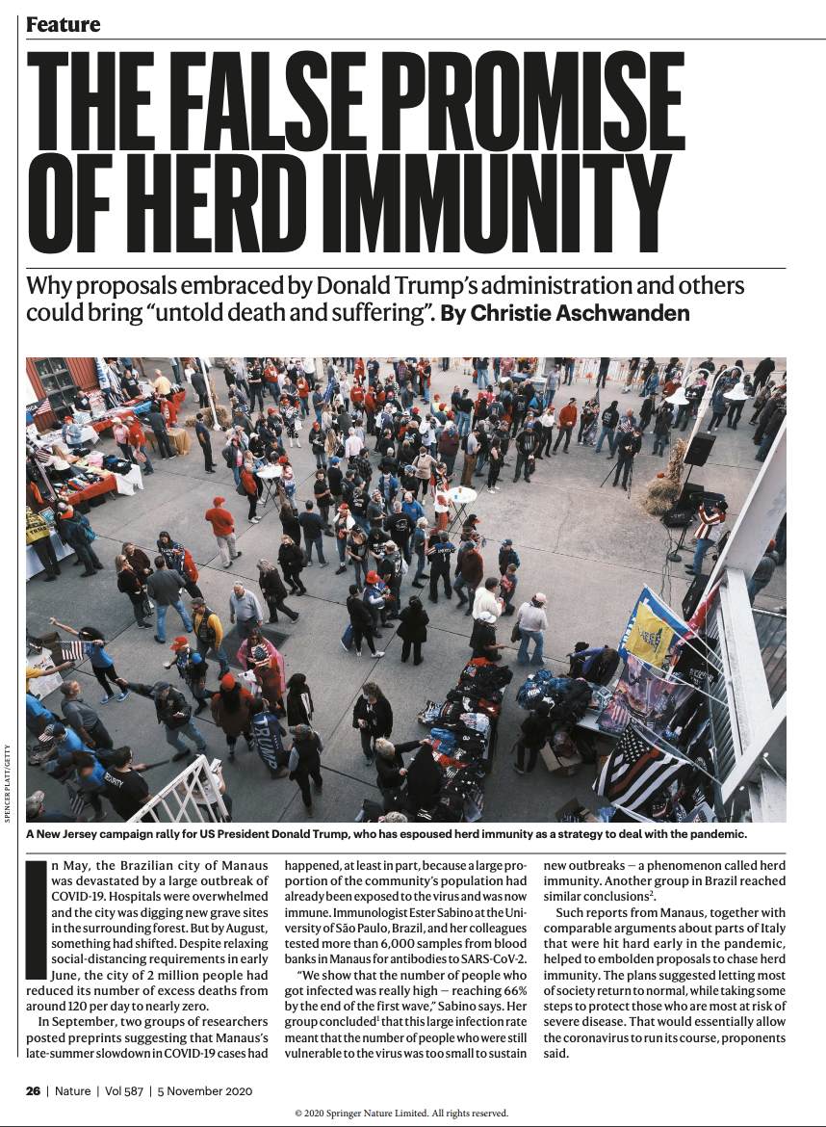
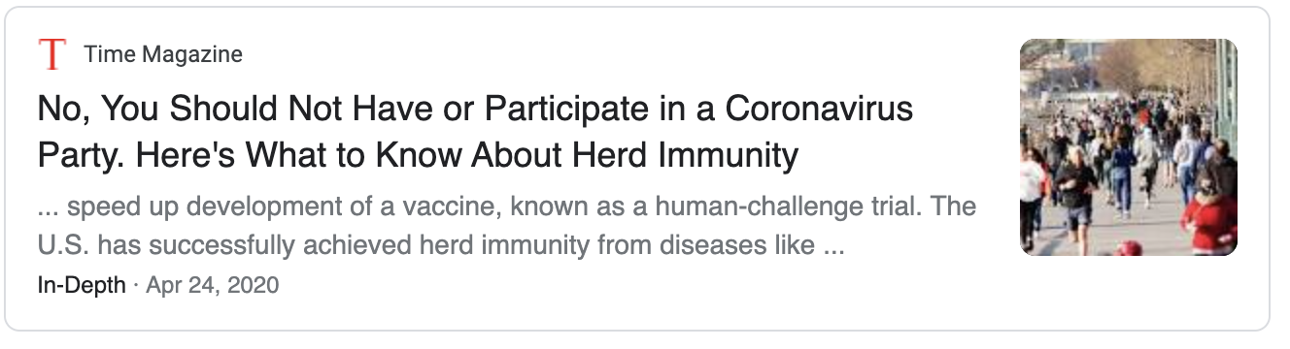
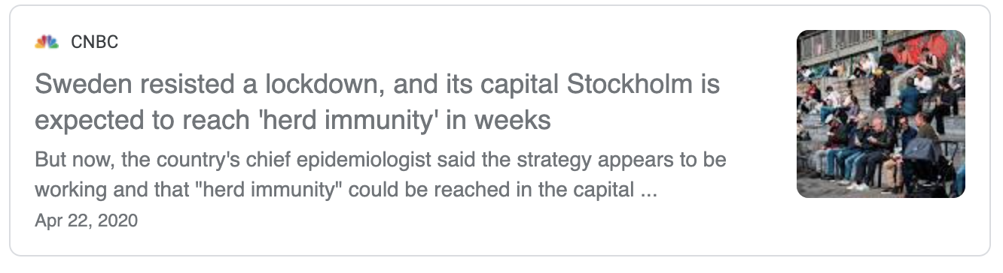
Initially, Some Debates About Herd Immunity Strategies

Slide 5
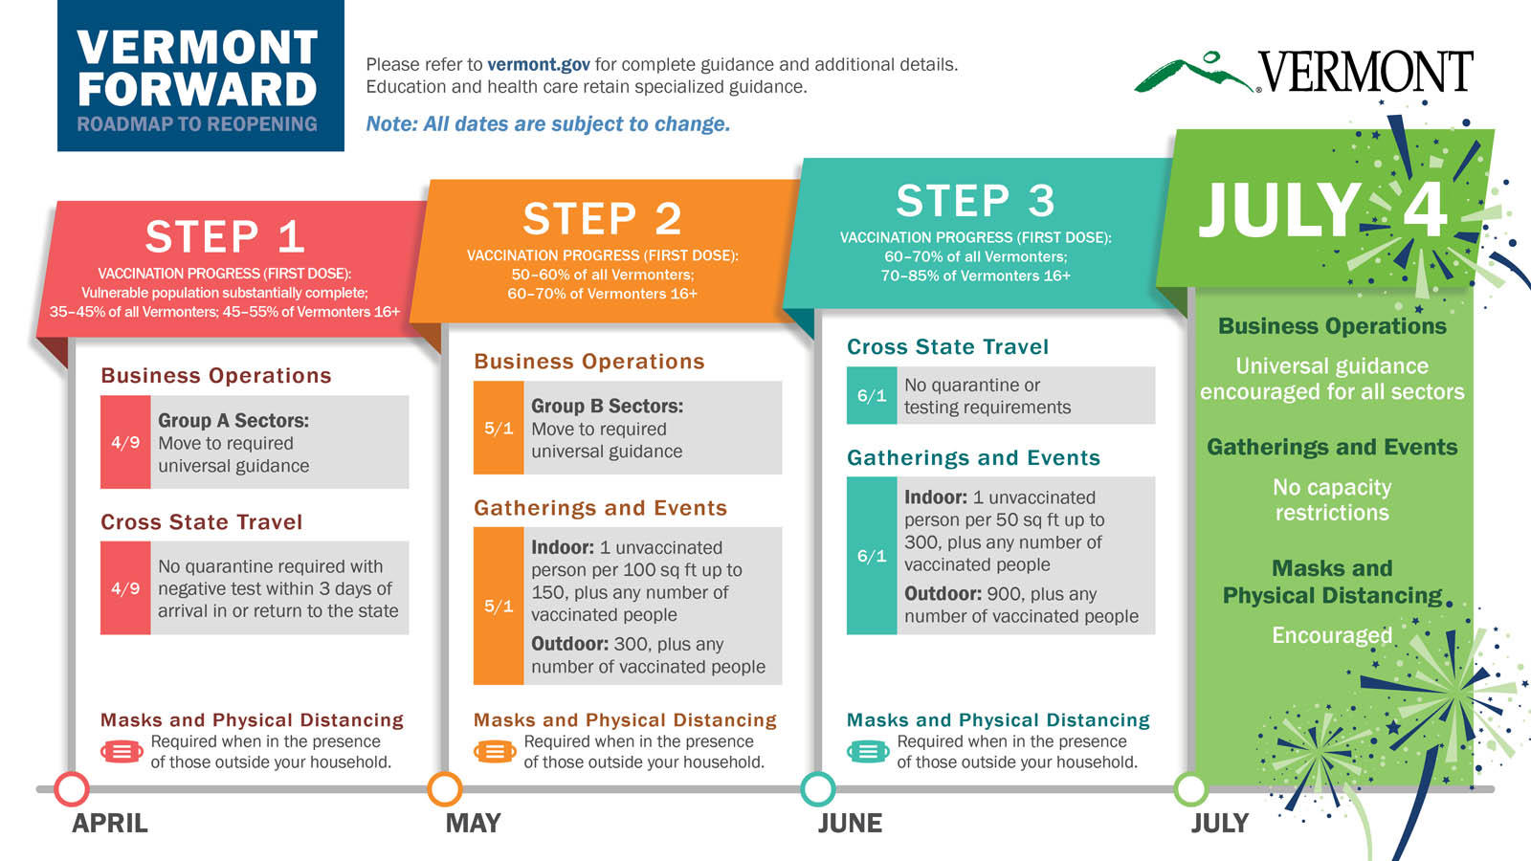

Slide 6
Unanswered Questions
Does a mitigation strategy ever make sense? Under what conditions?
What is the best way to design social distancing strategies to protect vulnerable populations?

Slide 7
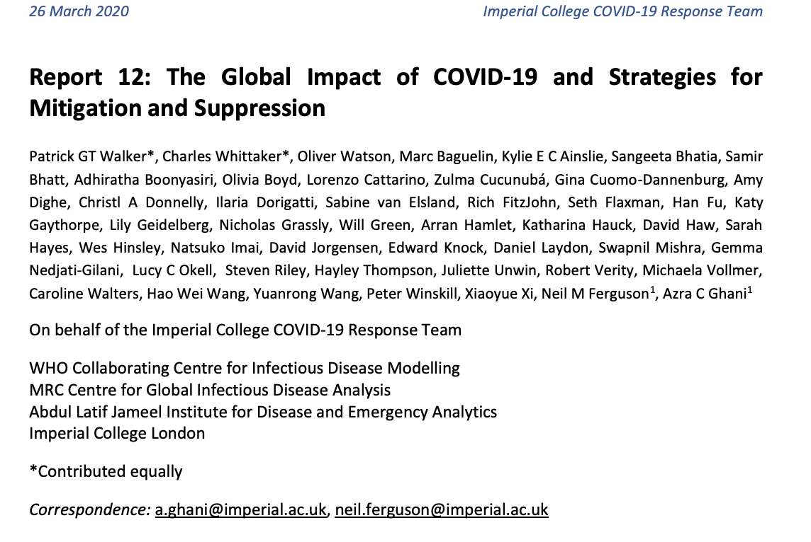
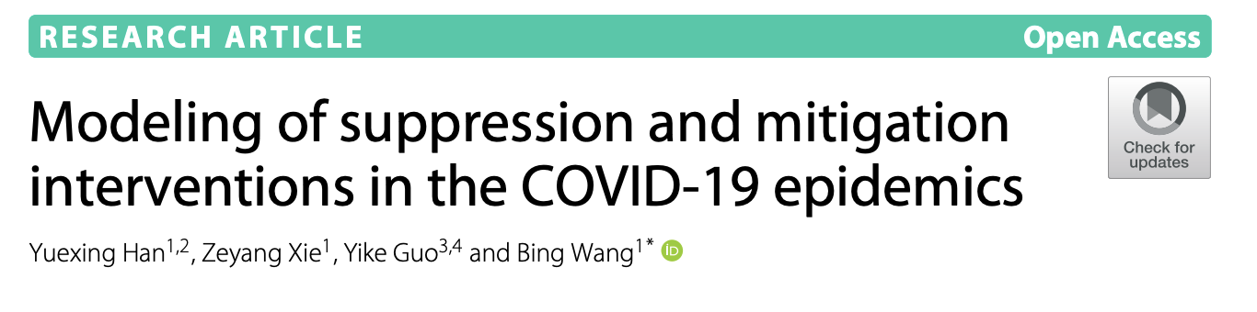
Most COVID-19 Modeling Examines Pre-Specified Policies
Policy Scenarios
Model
Outcomes

Slide 8
With Optimization, Policies Are Not Pre-Specified
Cost Function
Model
Optimal Policy

Slide 9
Optimizing Social Distancing Policy Is A High-Dimensional Problem
Can choose between different levels of social distancing
Can choose timing of interventions

Slide 10
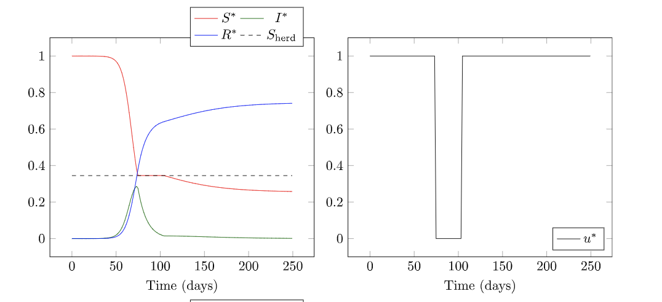
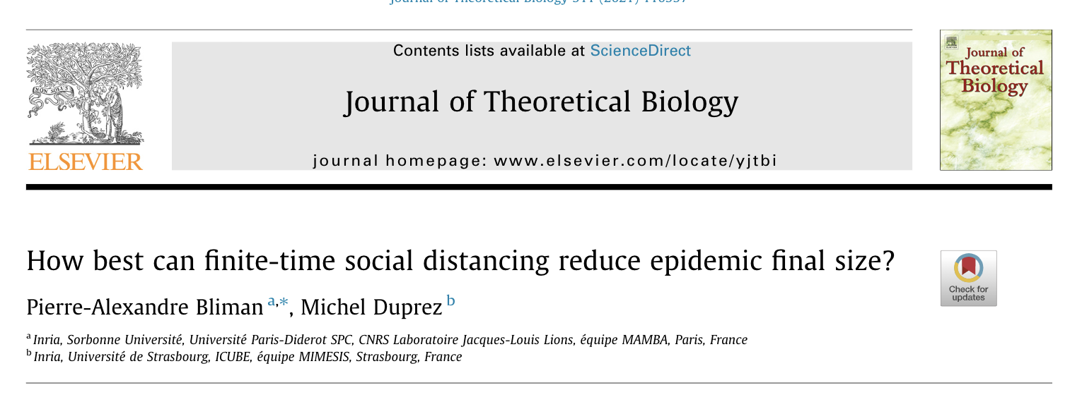
Make the Problem Easier By Simplifying the Problem Space

Slide 11
Calculus of Variations Can Find an Optimal Curve
https://mathematicalgarden.wordpress.com/2014/09/06/soap-film-and-minimal-surface/

Slide 12
Key Model Parameters
Tfinal – how long do you need to use nonpharmaceutical interventions for?
c – Cost of social distancing relative to cost of infections
R0 – Reproduction number
i0 – Initial infections when NPIs are put in place
Note: Model is SIR

Slide 13
The “c” cost of social distancing parameter
Higher c | Lower c
More asymptomatic spread (more difficult to reduce R0) | Easy to identify contagious individuals
Airborne transmission | Limited transmission modes
Less severe illness | More severe illness

Slide 14
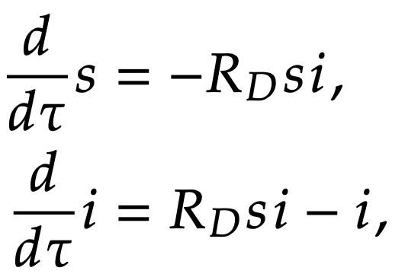
Time-Dependent Disease Dynamics

Slide 15
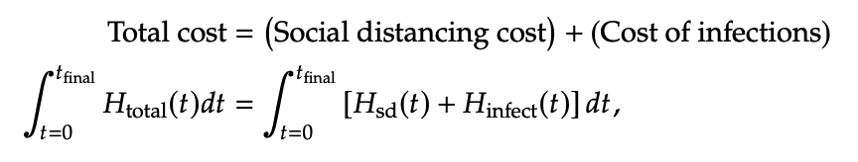
Cost Function (Dimensional)

Slide 16
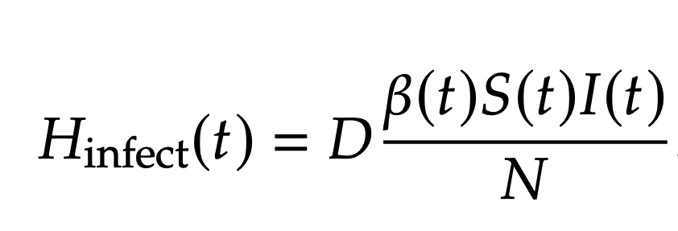
Costs of Infection
New infections per unit time
Cost per infection

Slide 17
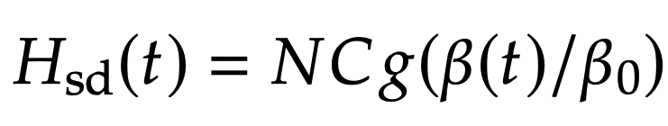
Costs of Social Distancing
Function of how much contacts are being reduced by
Cost of social distancing parameter (per person, per unit time)

Slide 18
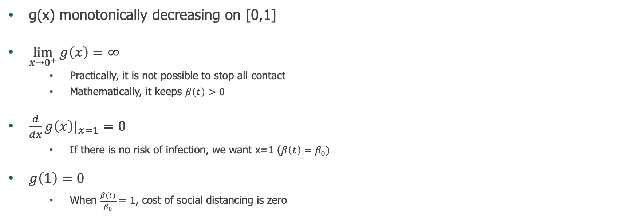
Properties we want in g(x)
g(x) monotonically decreasing on [0,1]
$\lim_{x→0^{+}}{g\left(x\right)=∞}$
Practically, it is not possible to stop all contact
Mathematically, it keeps $β\left(t\right)>0$
$\frac{d}{dx}g\left(x\right)|_{x=1}=0$
If there is no risk of infection, we want x=1 ($β\left(t\right)=β_{0})$
$g\left(1\right)=0$
When $\frac{β(t)}{β_{0}}=1$, cost of social distancing is zero

Slide 19
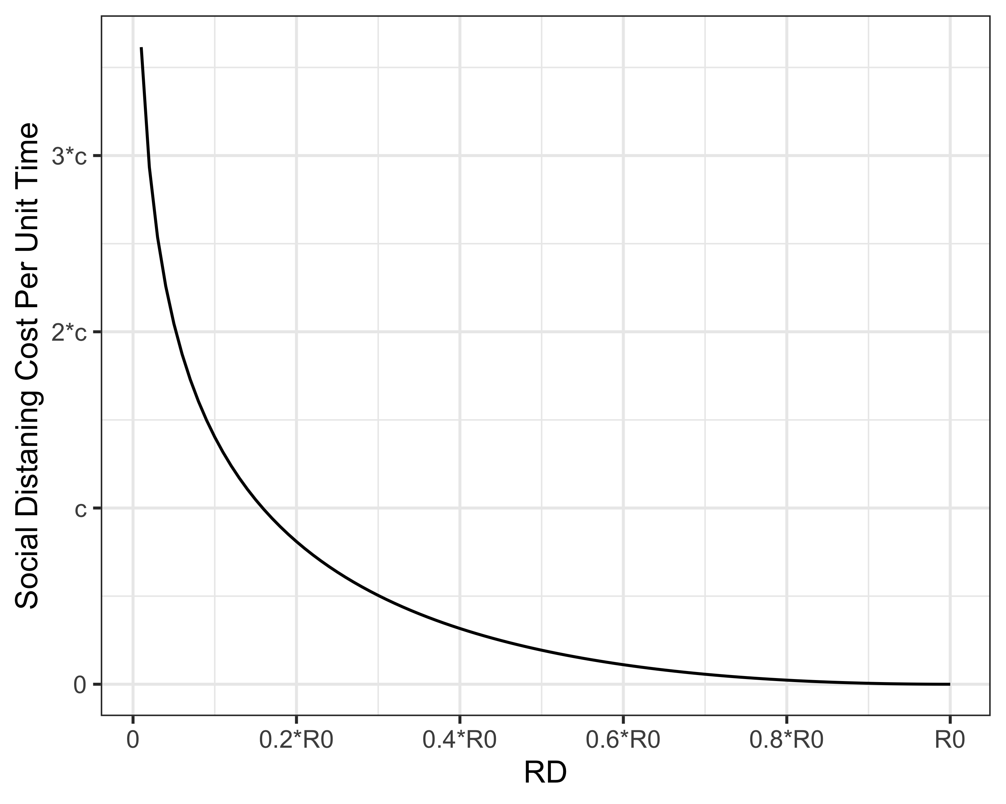
Assumption: Cost of Social Distancing Increases as RD Decreases
Cost to get RD<1 if R0 =5
Cost if R0 =2.5
Cost if R0 =1.5

Slide 20
Disease Transmission Parameters and Variables
R0 – reproduction number
RD – Social distancing policy we are solving for, variable function of time
Rt – Effective reproduction number, RD*s, accounts for transmission reduction due to social distancing AND recovered individuals

Slide 21
Final Epidemic Size vs. Min Required for Herd Immunity
 | R0 = 1.5 | R0 = 2.5 | R0 = 5
Uncontrolled final epidemic size | 58% | 89% | 99.3%
Min for herd immunity | 33% | 60% | 80%

Slide 22
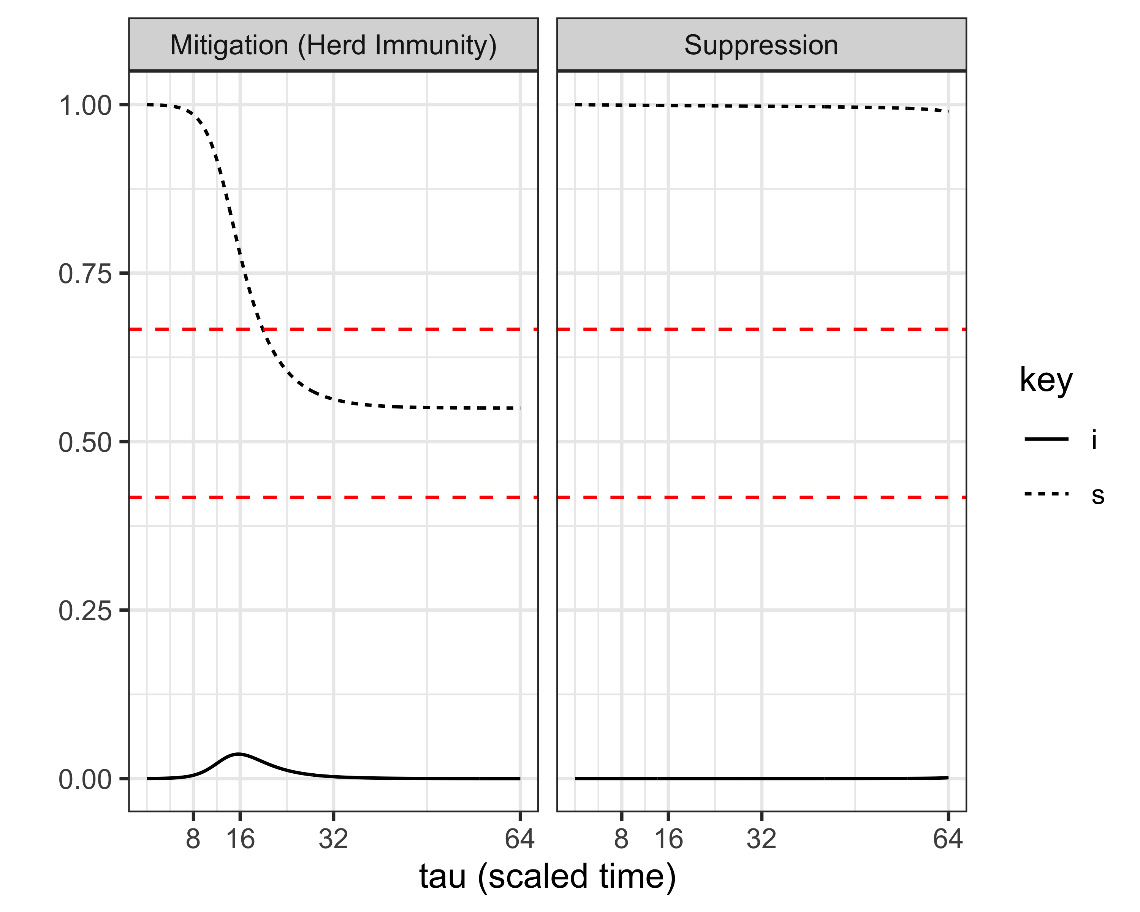
Mitigation (Herd Immunity) vs. Suppression Strategies
Maximum susceptibles for herd immunity
Uncontrolled final epidemic size

Slide 23
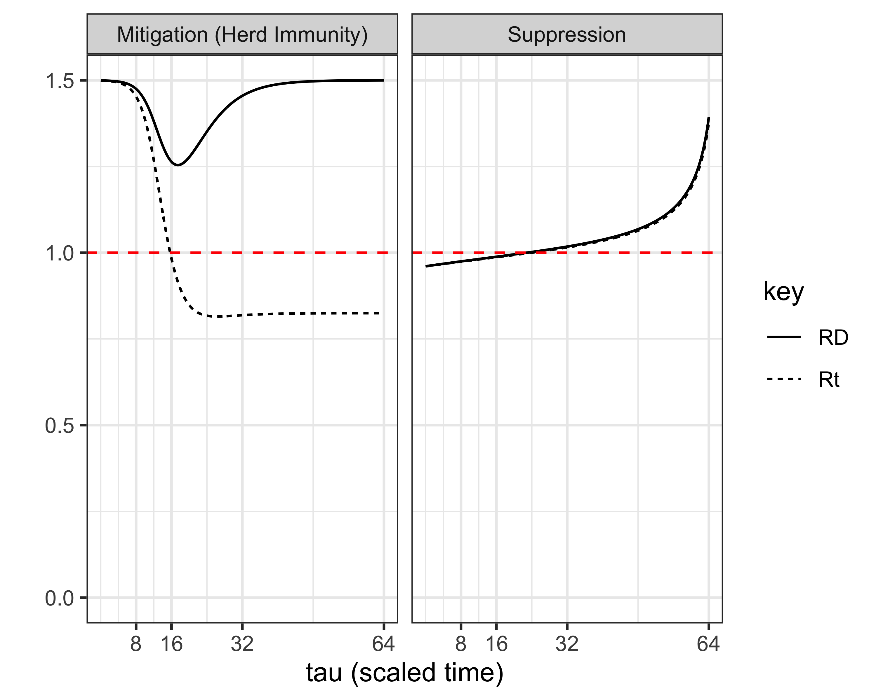
Mitigation (Herd Immunity) vs. Suppression Strategies

Slide 24
Mitigation (Herd Immunity) vs. Suppression Strategies, Summary
 | Mitigation | Suppression
Policy | Delay in “lockdown”, coincides with peak infections, eventual full re-opening | Initial “lockdown” + gradual re-opening
Infections | Substantial number become infected, usual at least enough to lead to herd immunity | Remains very low
Susceptibles | Substantial decline over time | Remains close to total population
Rt (effective reproduction number) | Decreases as a result of decrease in susceptible population and/or social distancing | Decreases as a result of social distancing only

Slide 25
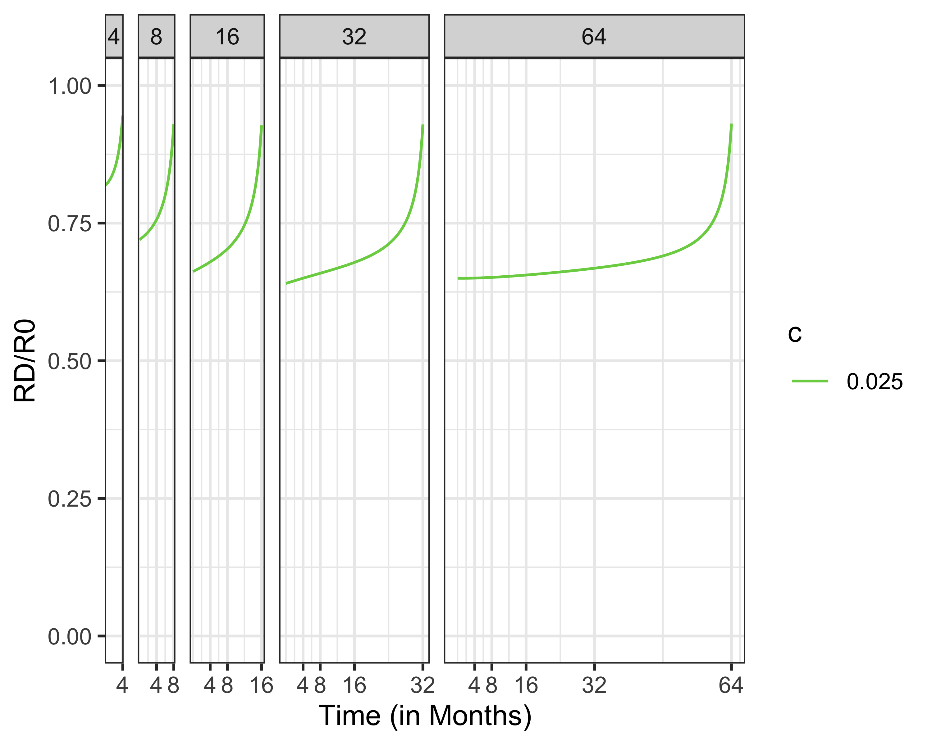
Effect of Tfinal, Length of NPI Period
“It’ll disappear when the weather gets warm”
“It’ll be years until a vaccine”

Slide 26
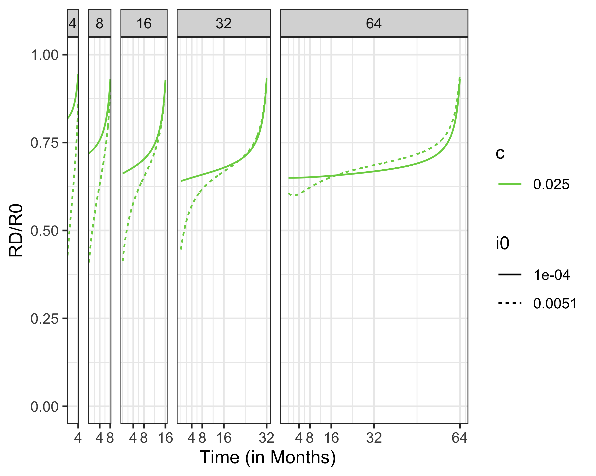
You Need Stricter Lockdowns For Higher Initial Infection Sizes

Slide 27
Social Distancing Policies at Low (Relative) Social Distancing Cost

Slide 28
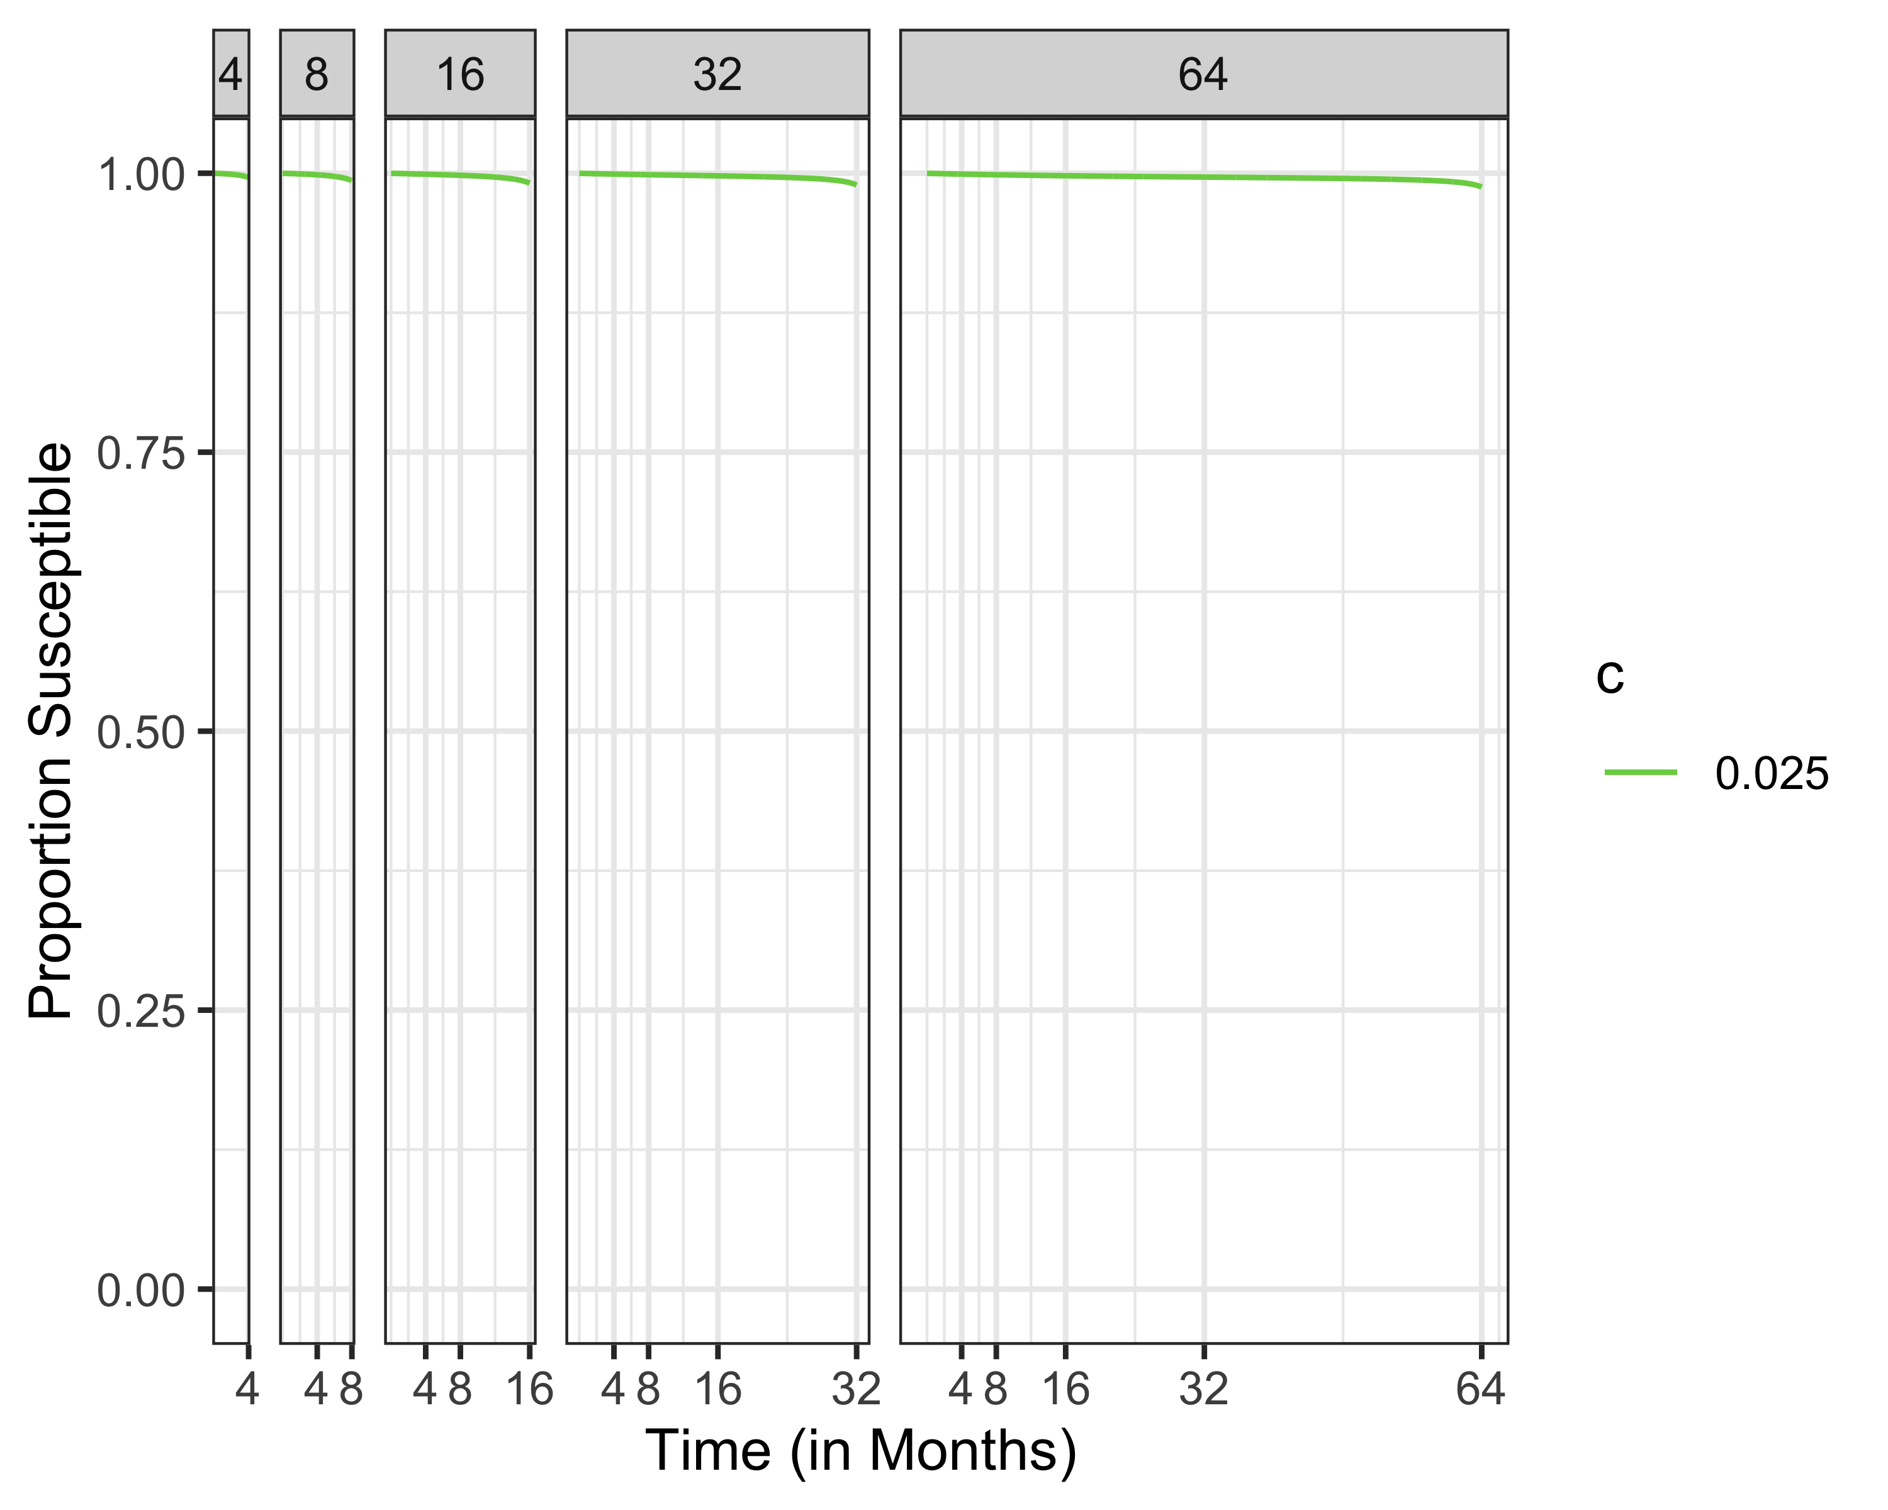
Susceptibles at Low (Relative) Social Distancing Cost

Slide 29
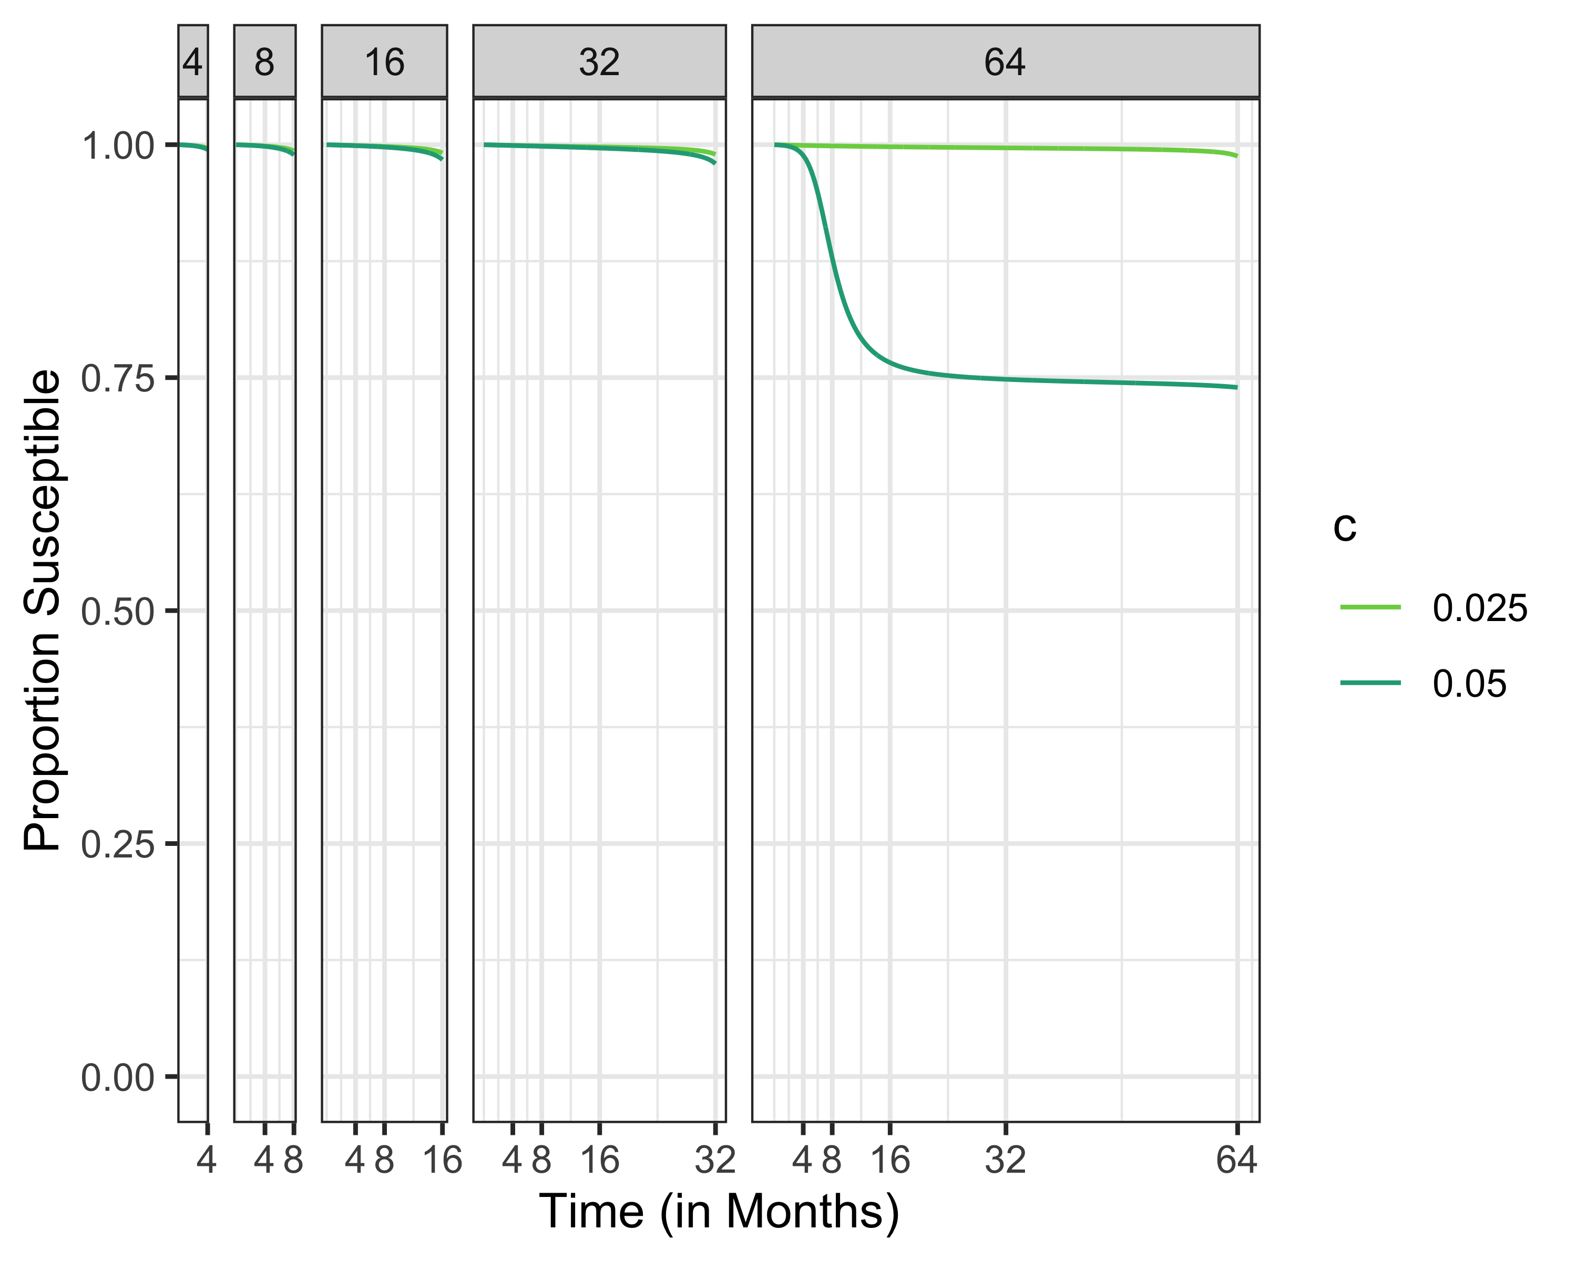
Proportion Susceptible, Increasing Social Distancing Cost

Slide 30
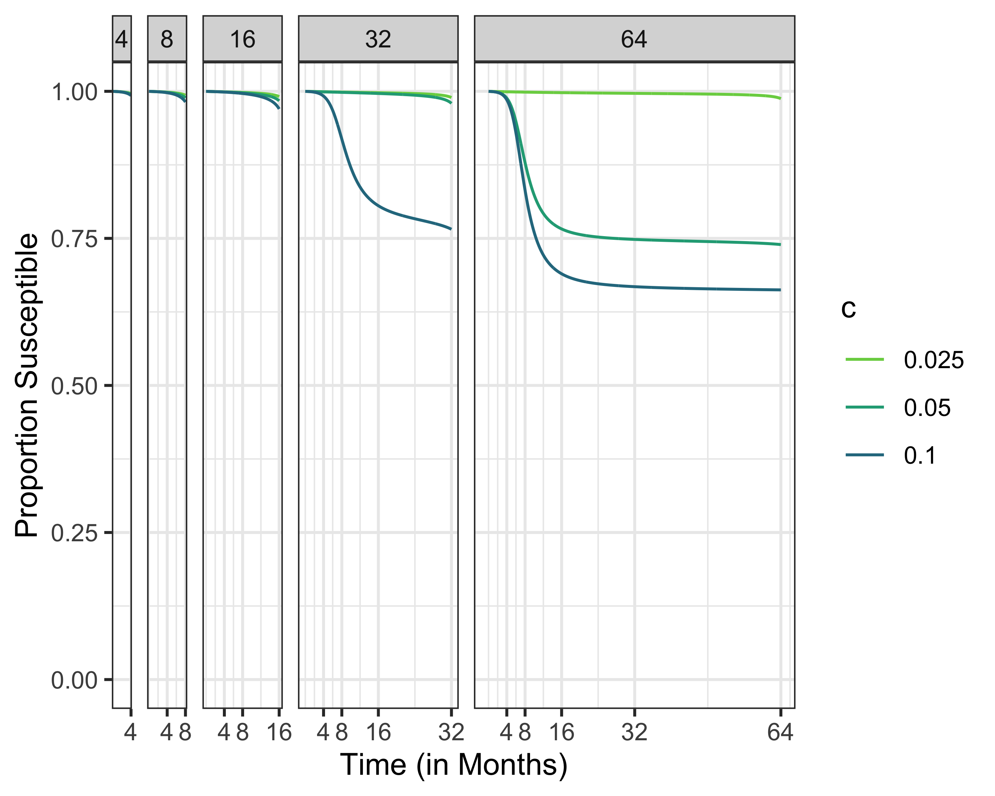
Susceptibles Different Time Horizons

Slide 31
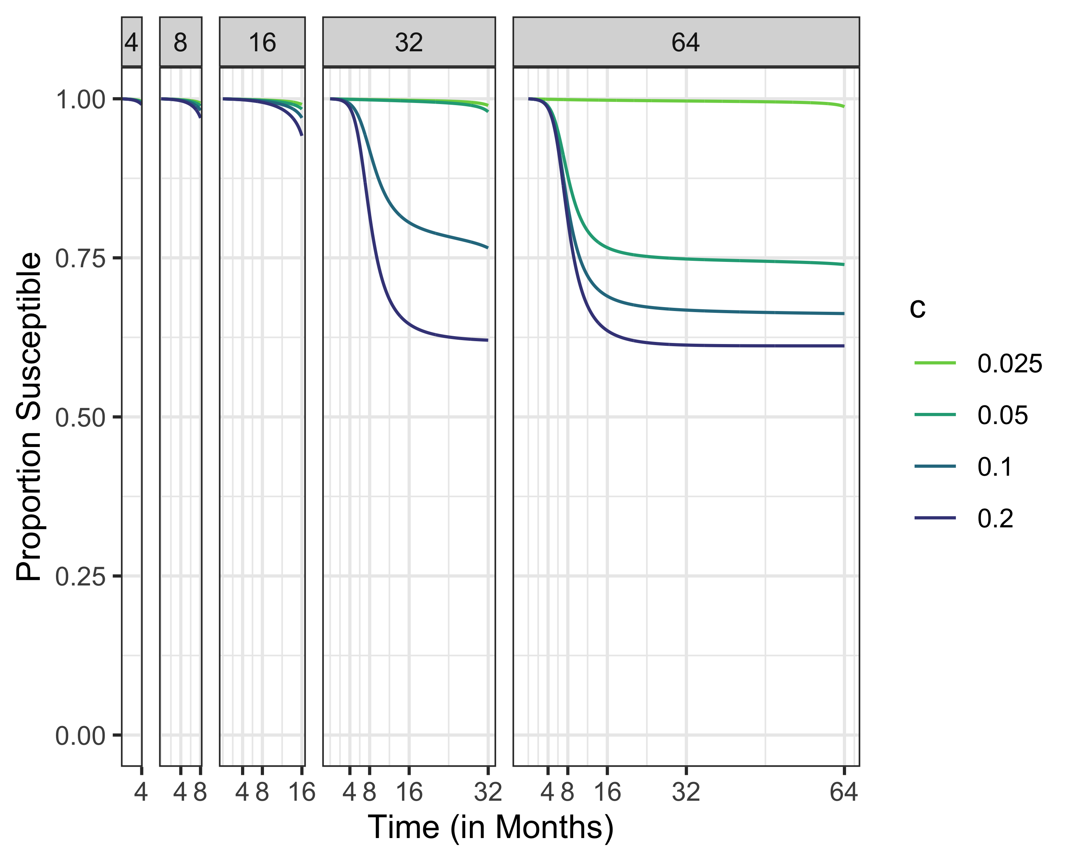
Susceptibles Different Time Horizons

Slide 32
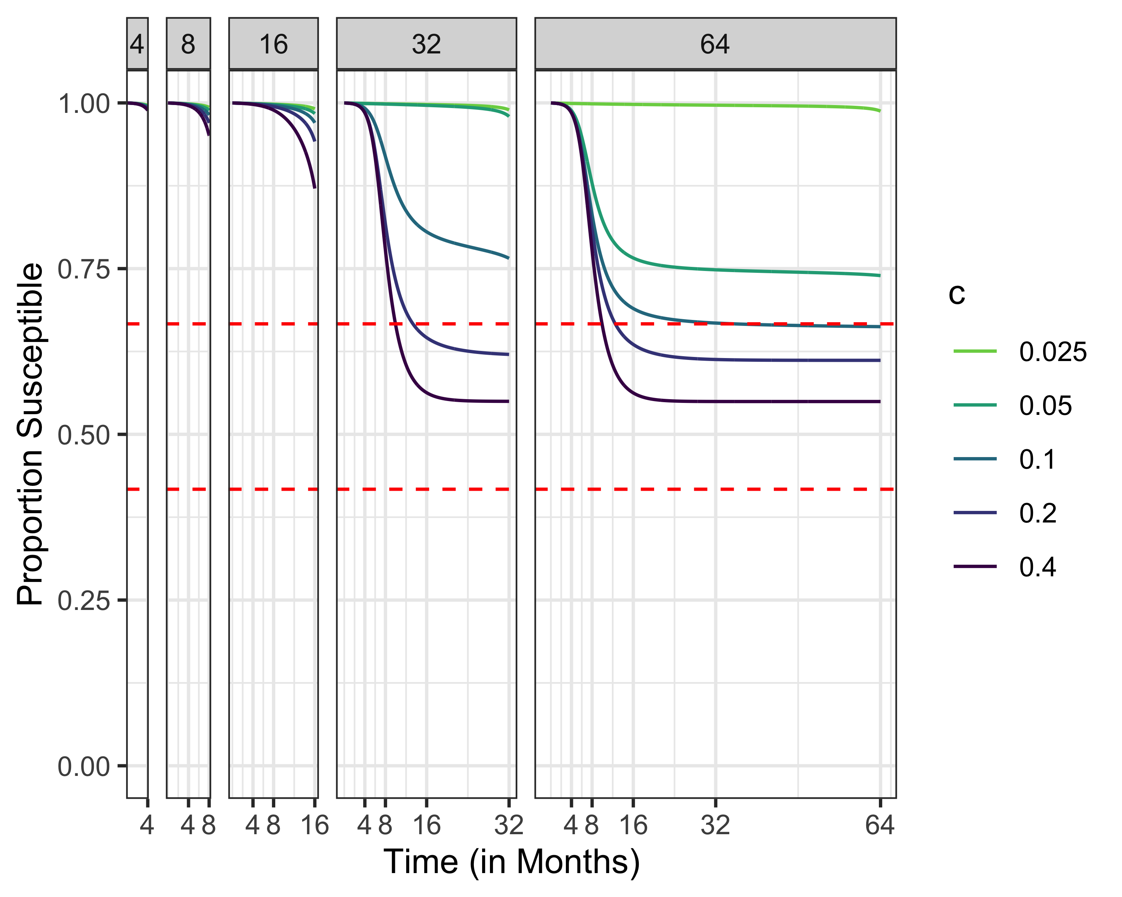
Susceptibles, R0 = 1.5
Maximum susceptibles for herd immunity
Uncontrolled final epidemic size

Slide 33
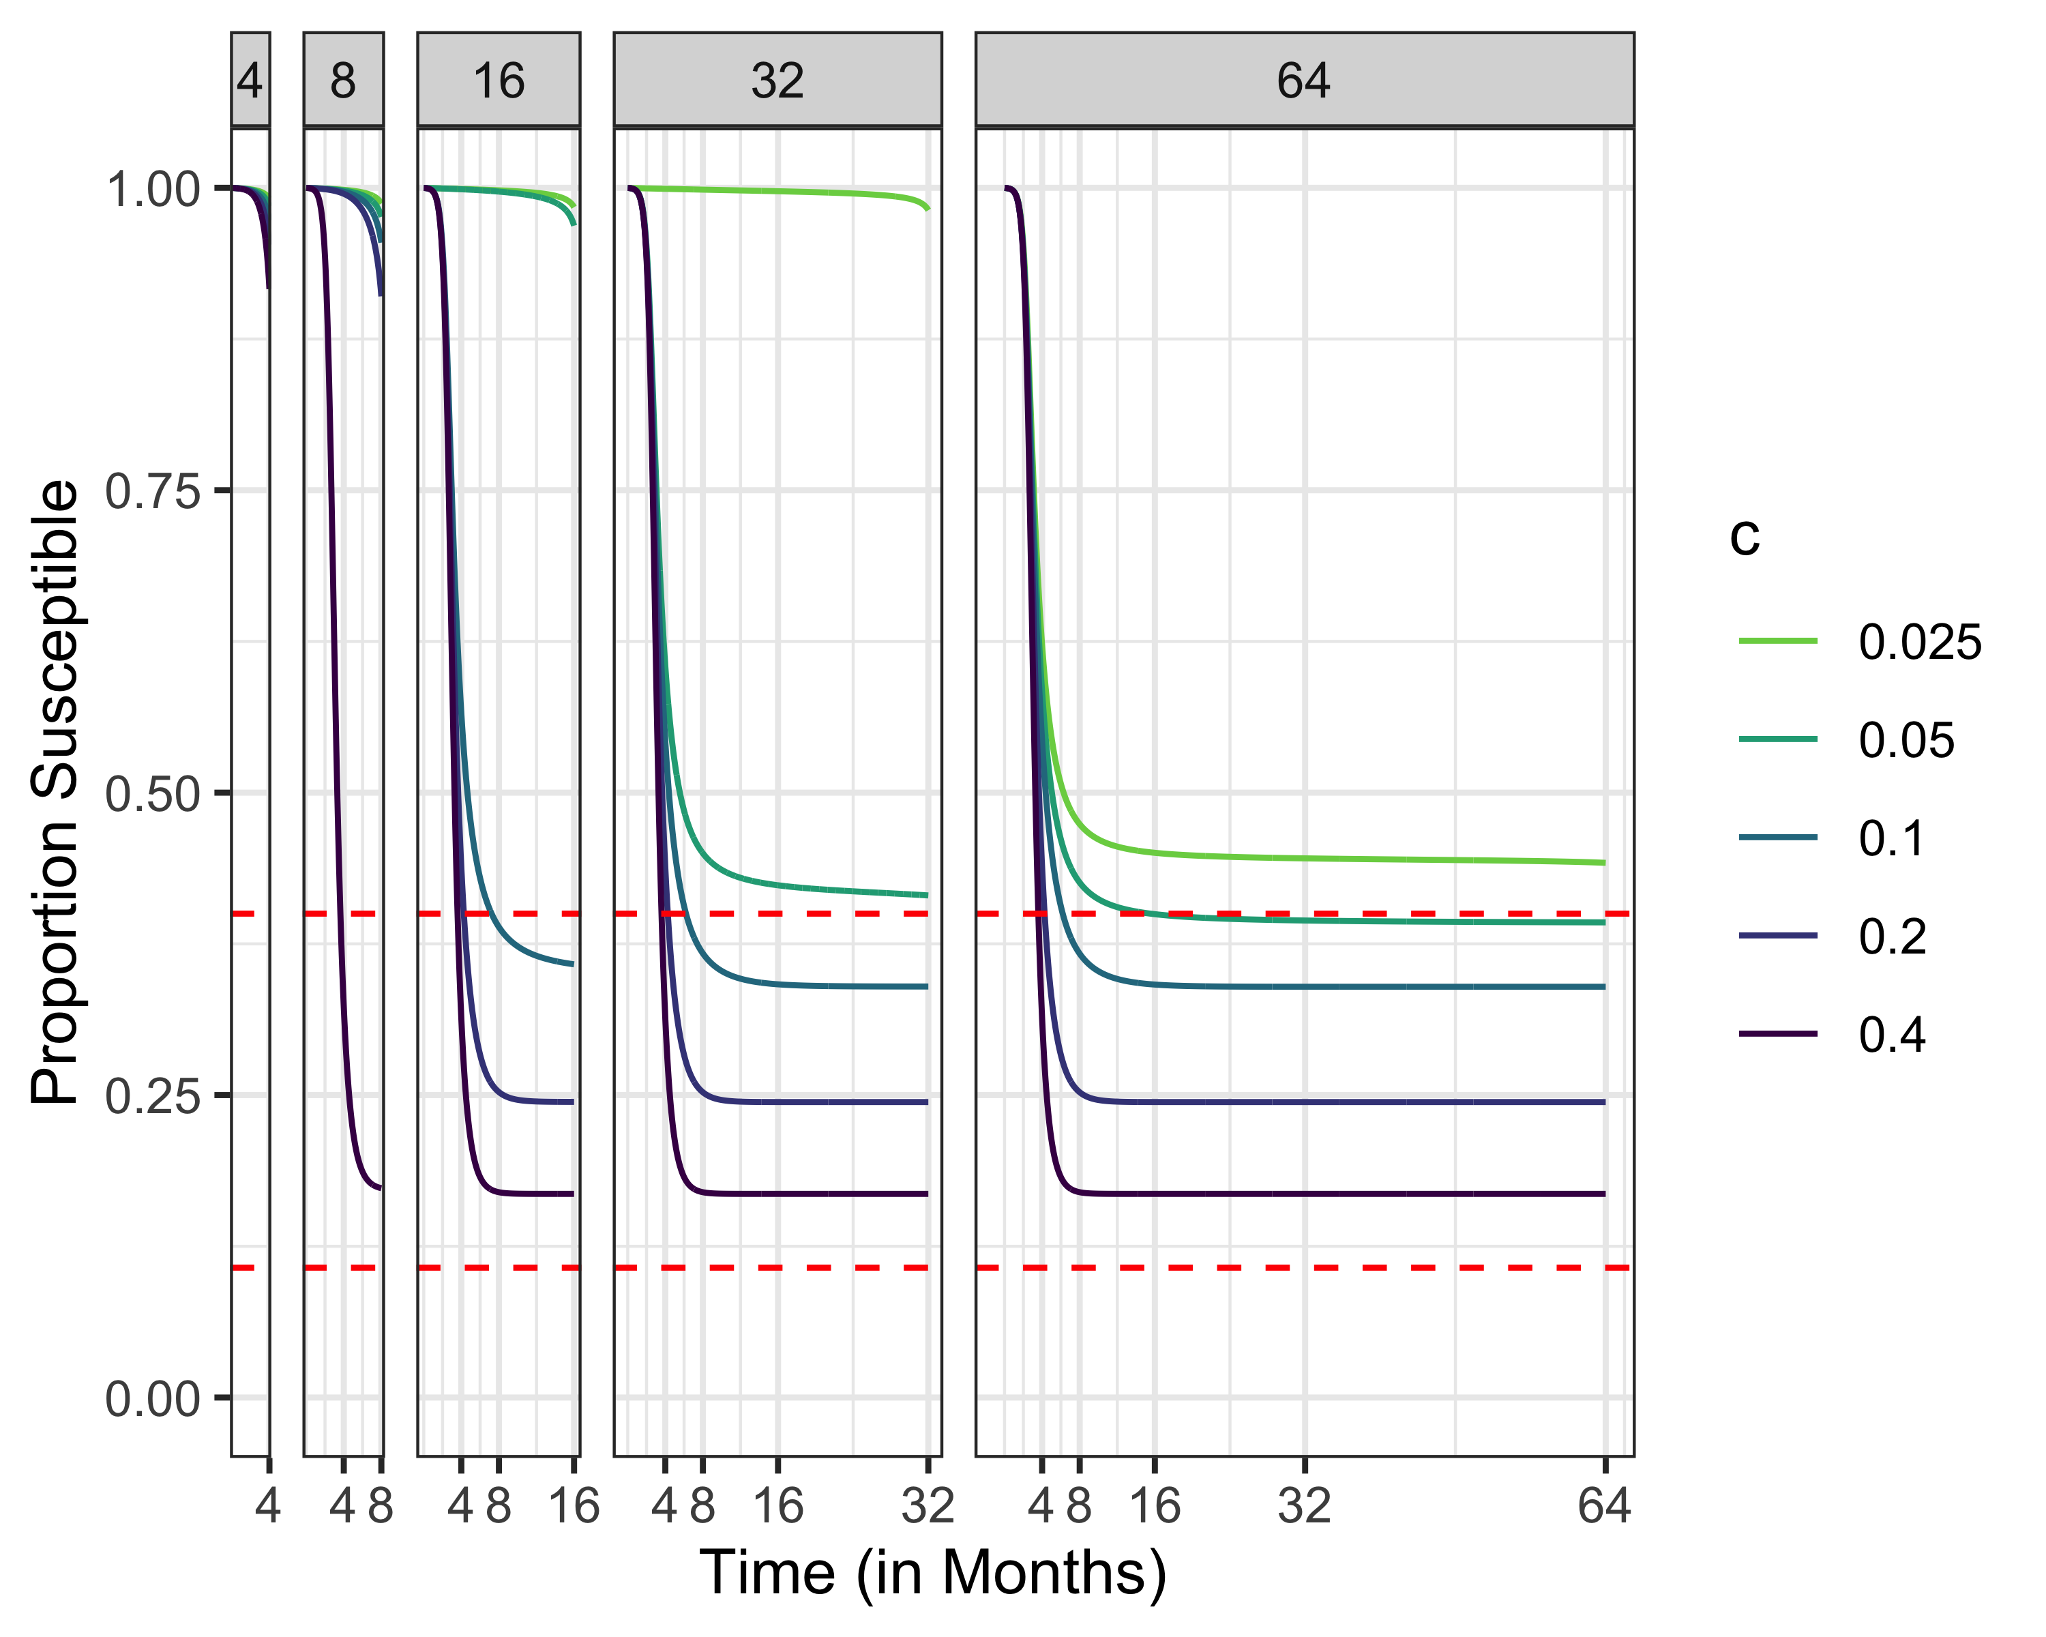
Susceptibles, R0 = 2.5
Maximum susceptibles for herd immunity
Uncontrolled final epidemic size

Slide 34
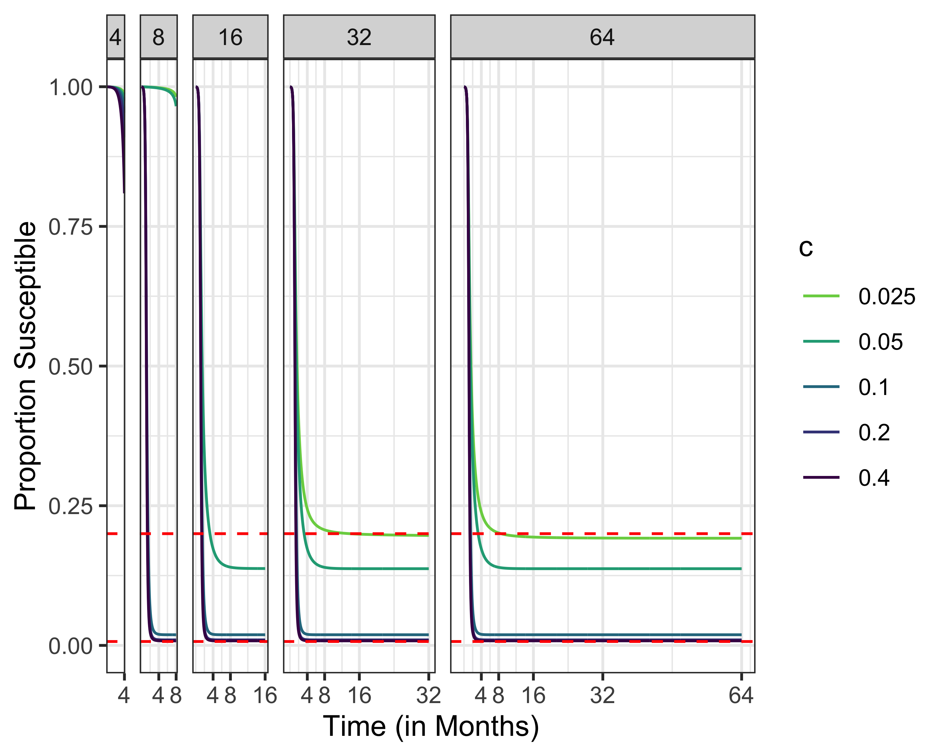
Susceptibles, R0 = 5
Maximum susceptibles for herd immunity
Uncontrolled final epidemic size

Slide 35
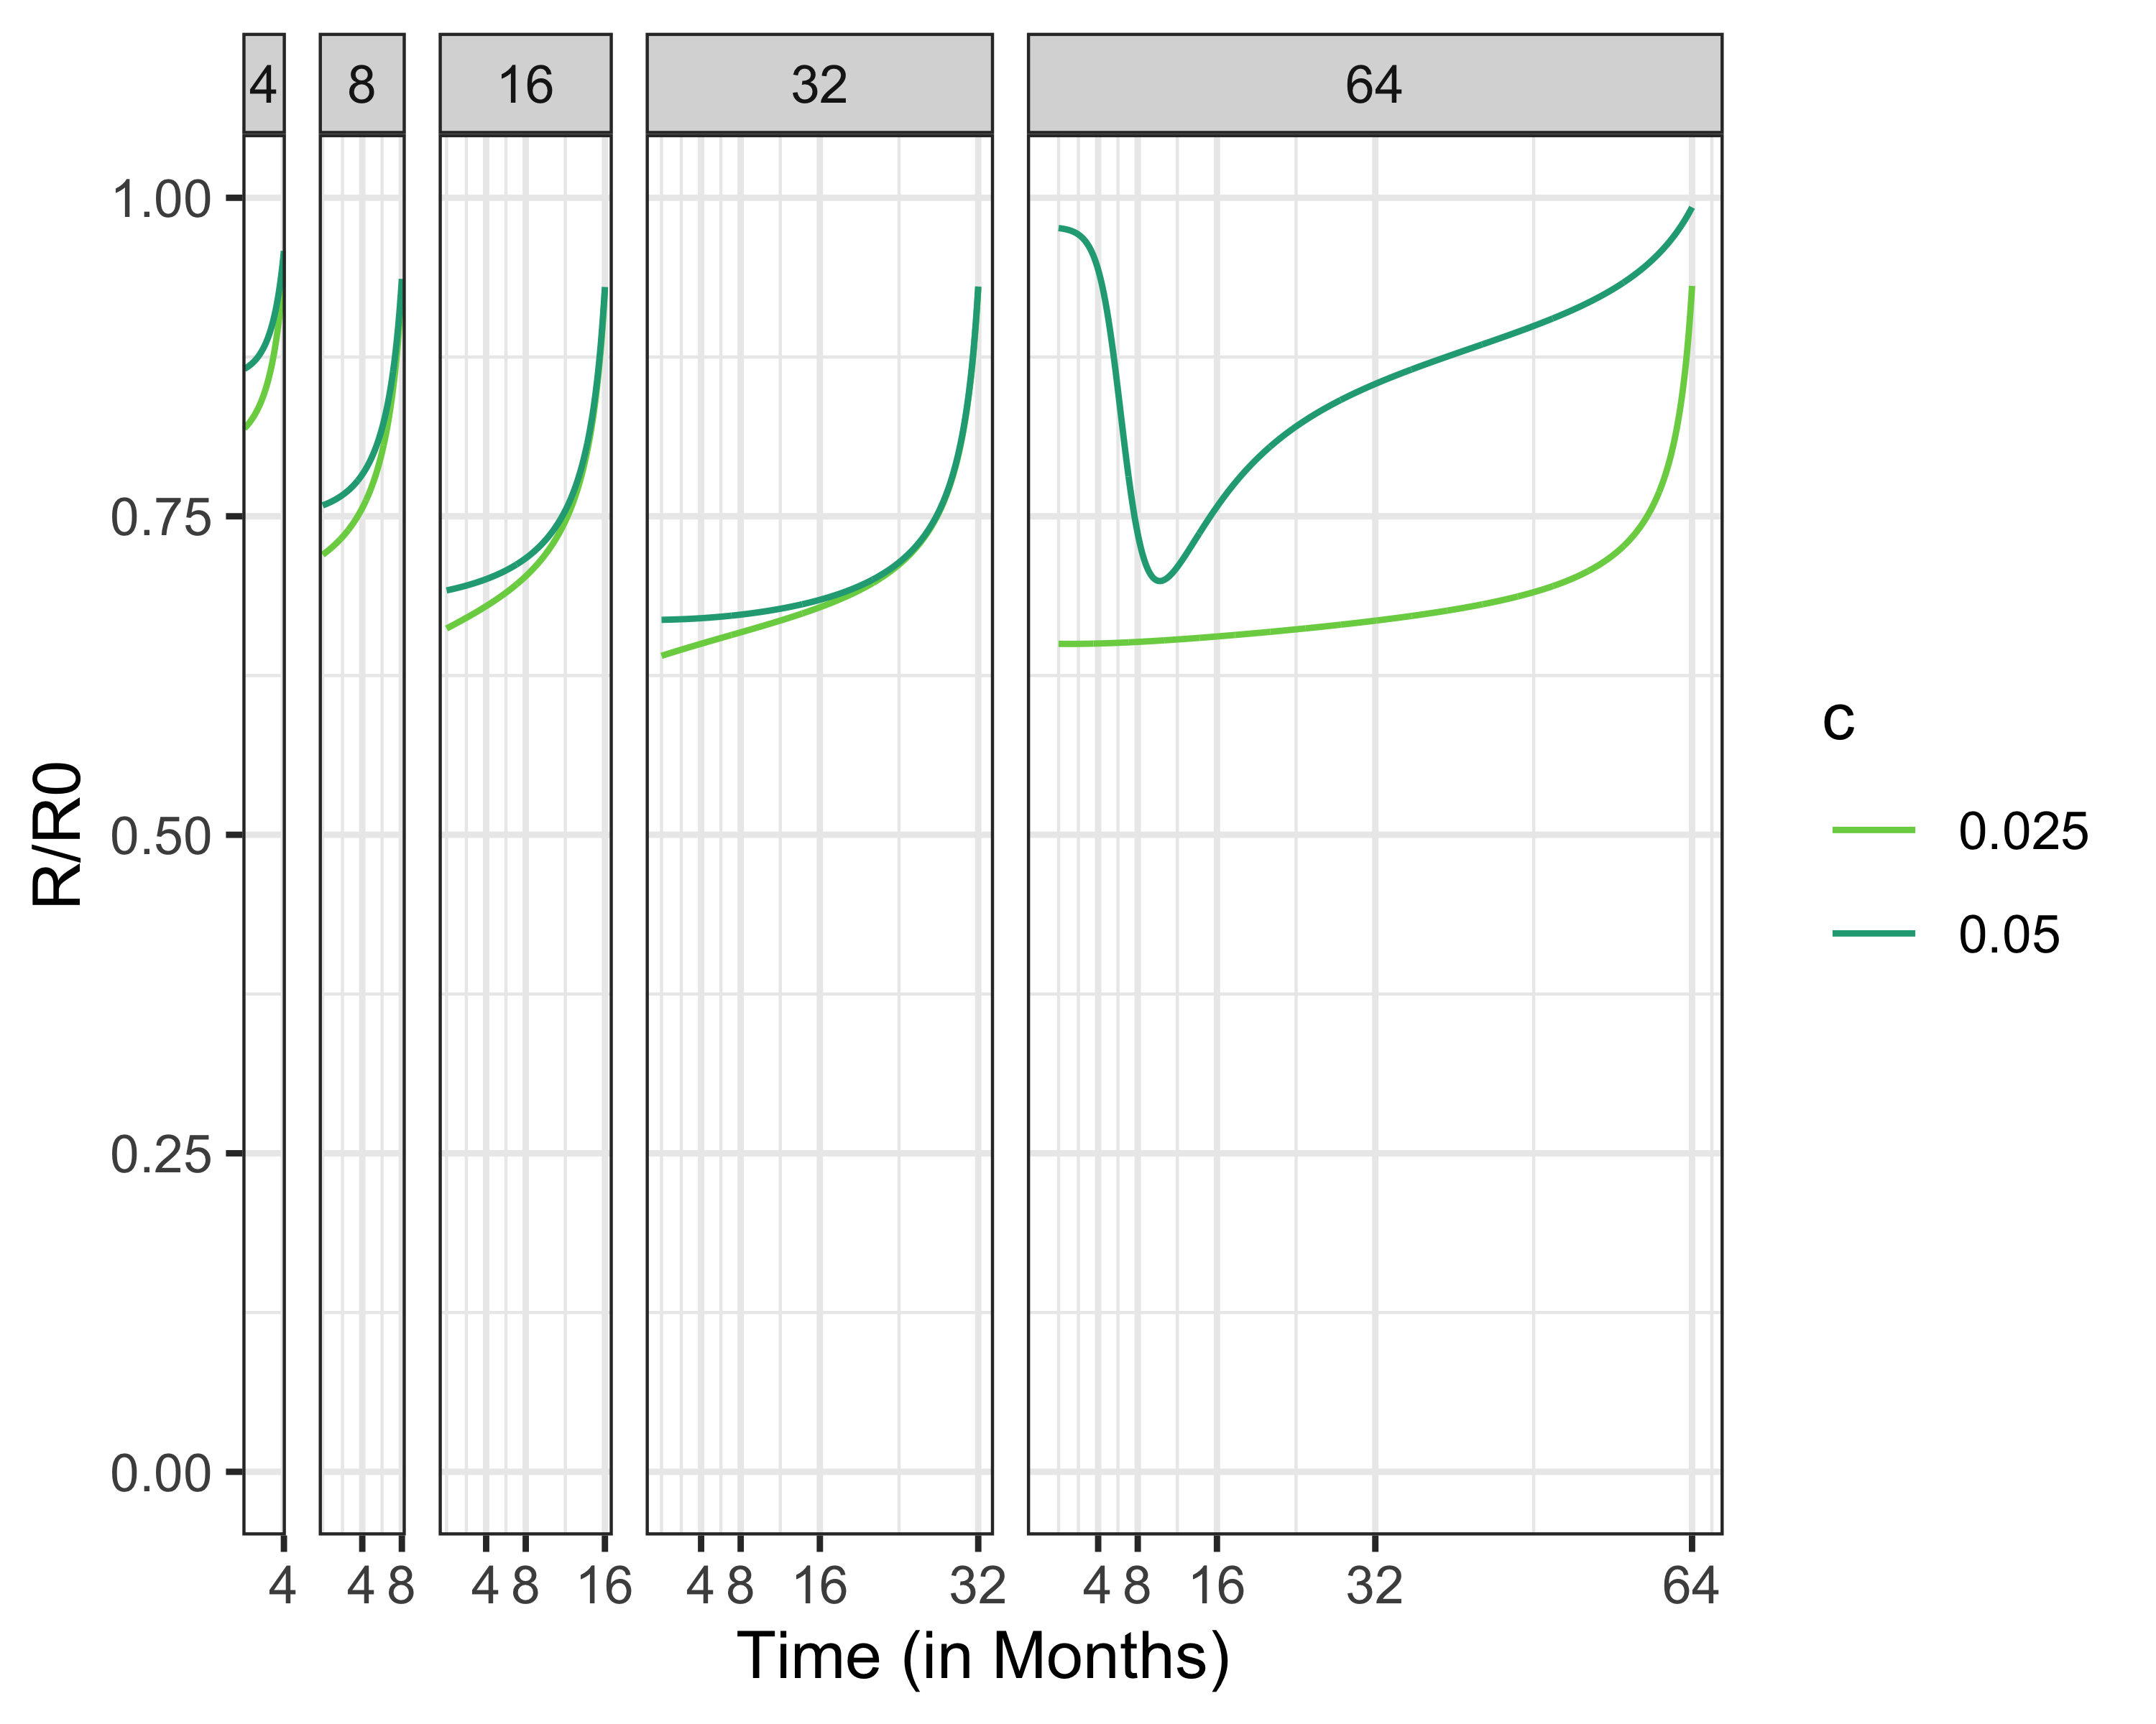
Social Distancing Policies, Increasing Social Distancing Cost

Slide 36
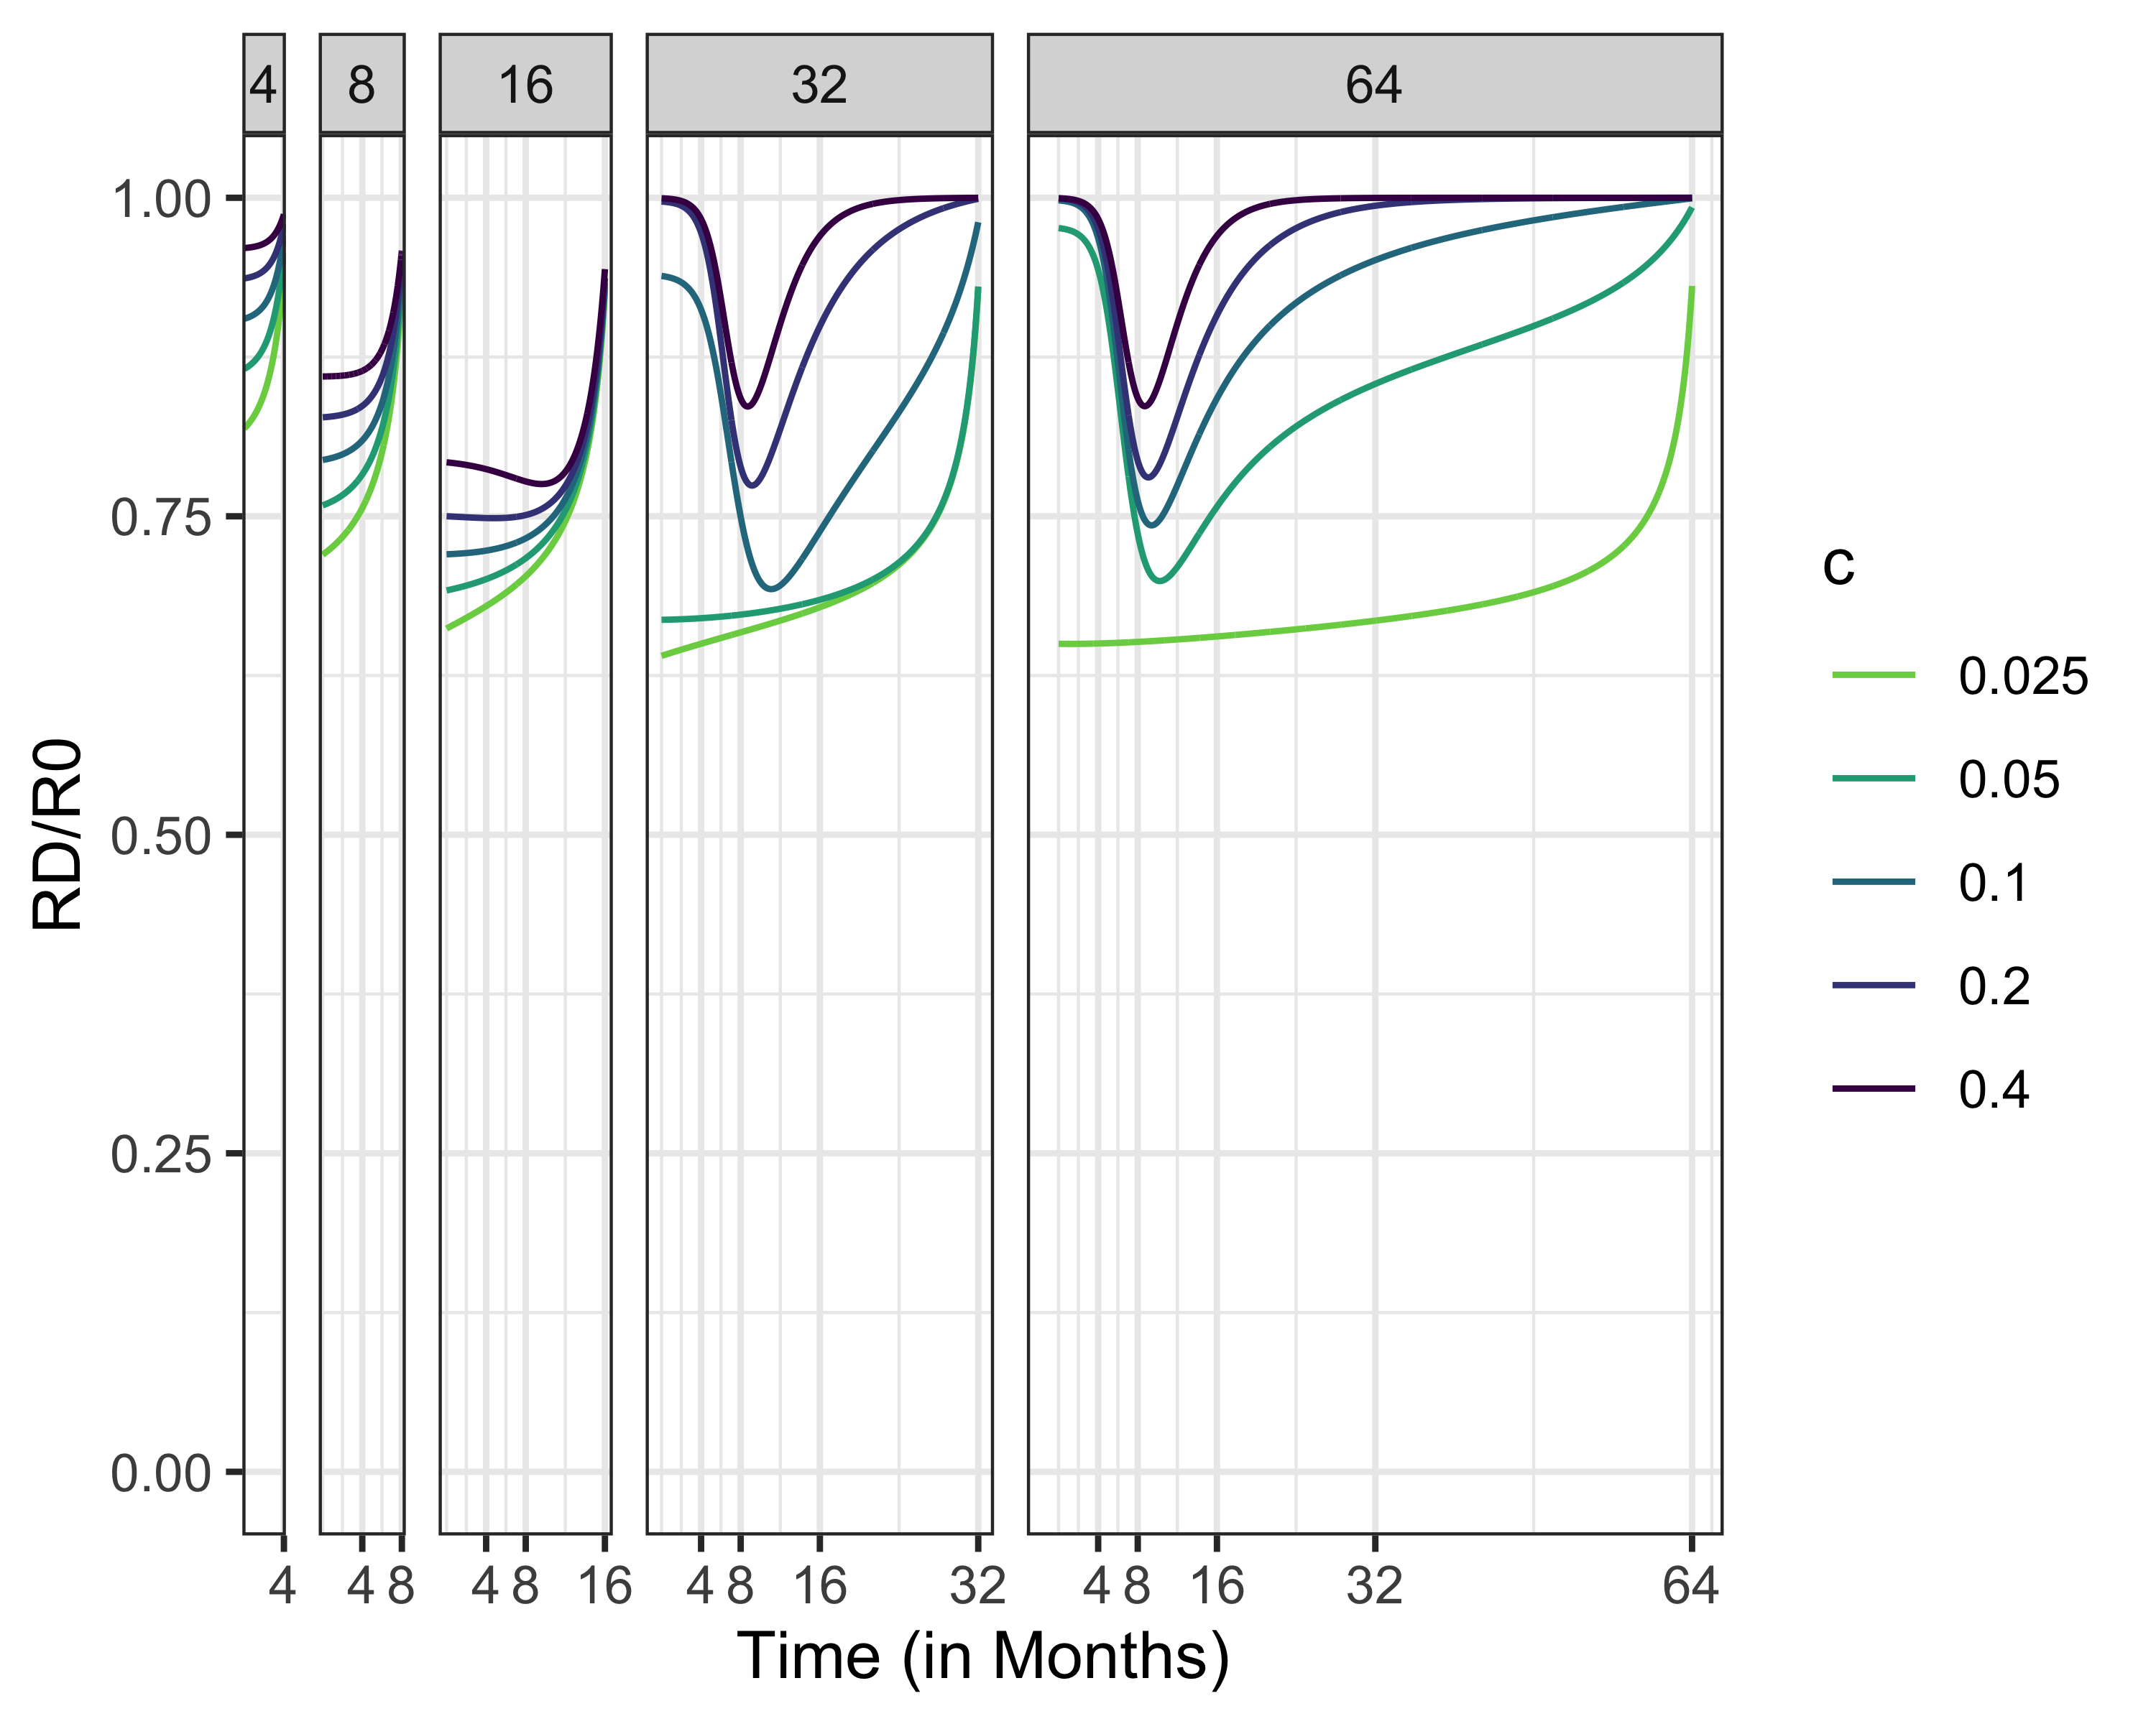
Social Distancing Policies, R0 = 1.5

Slide 37
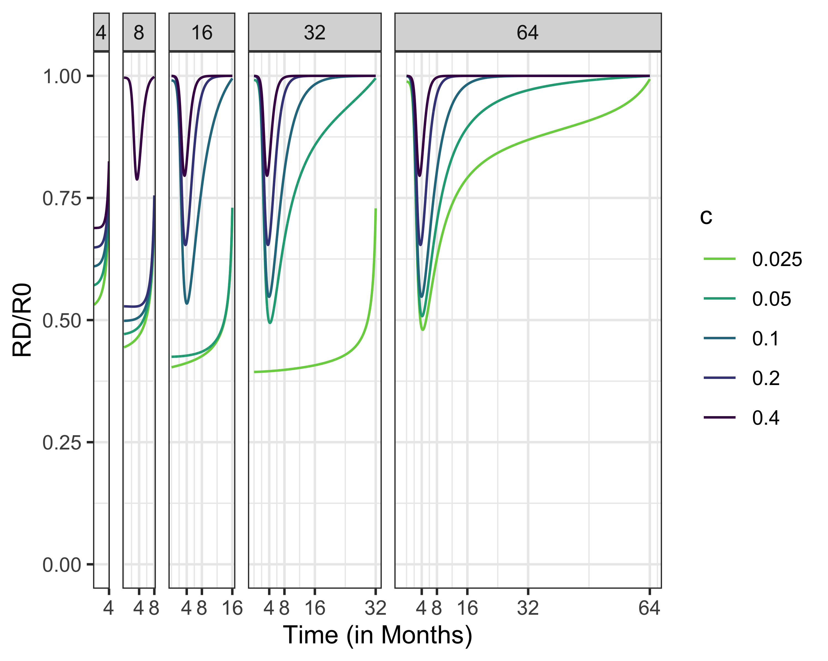
Social Distancing Policies, R0 = 2.5

Slide 38
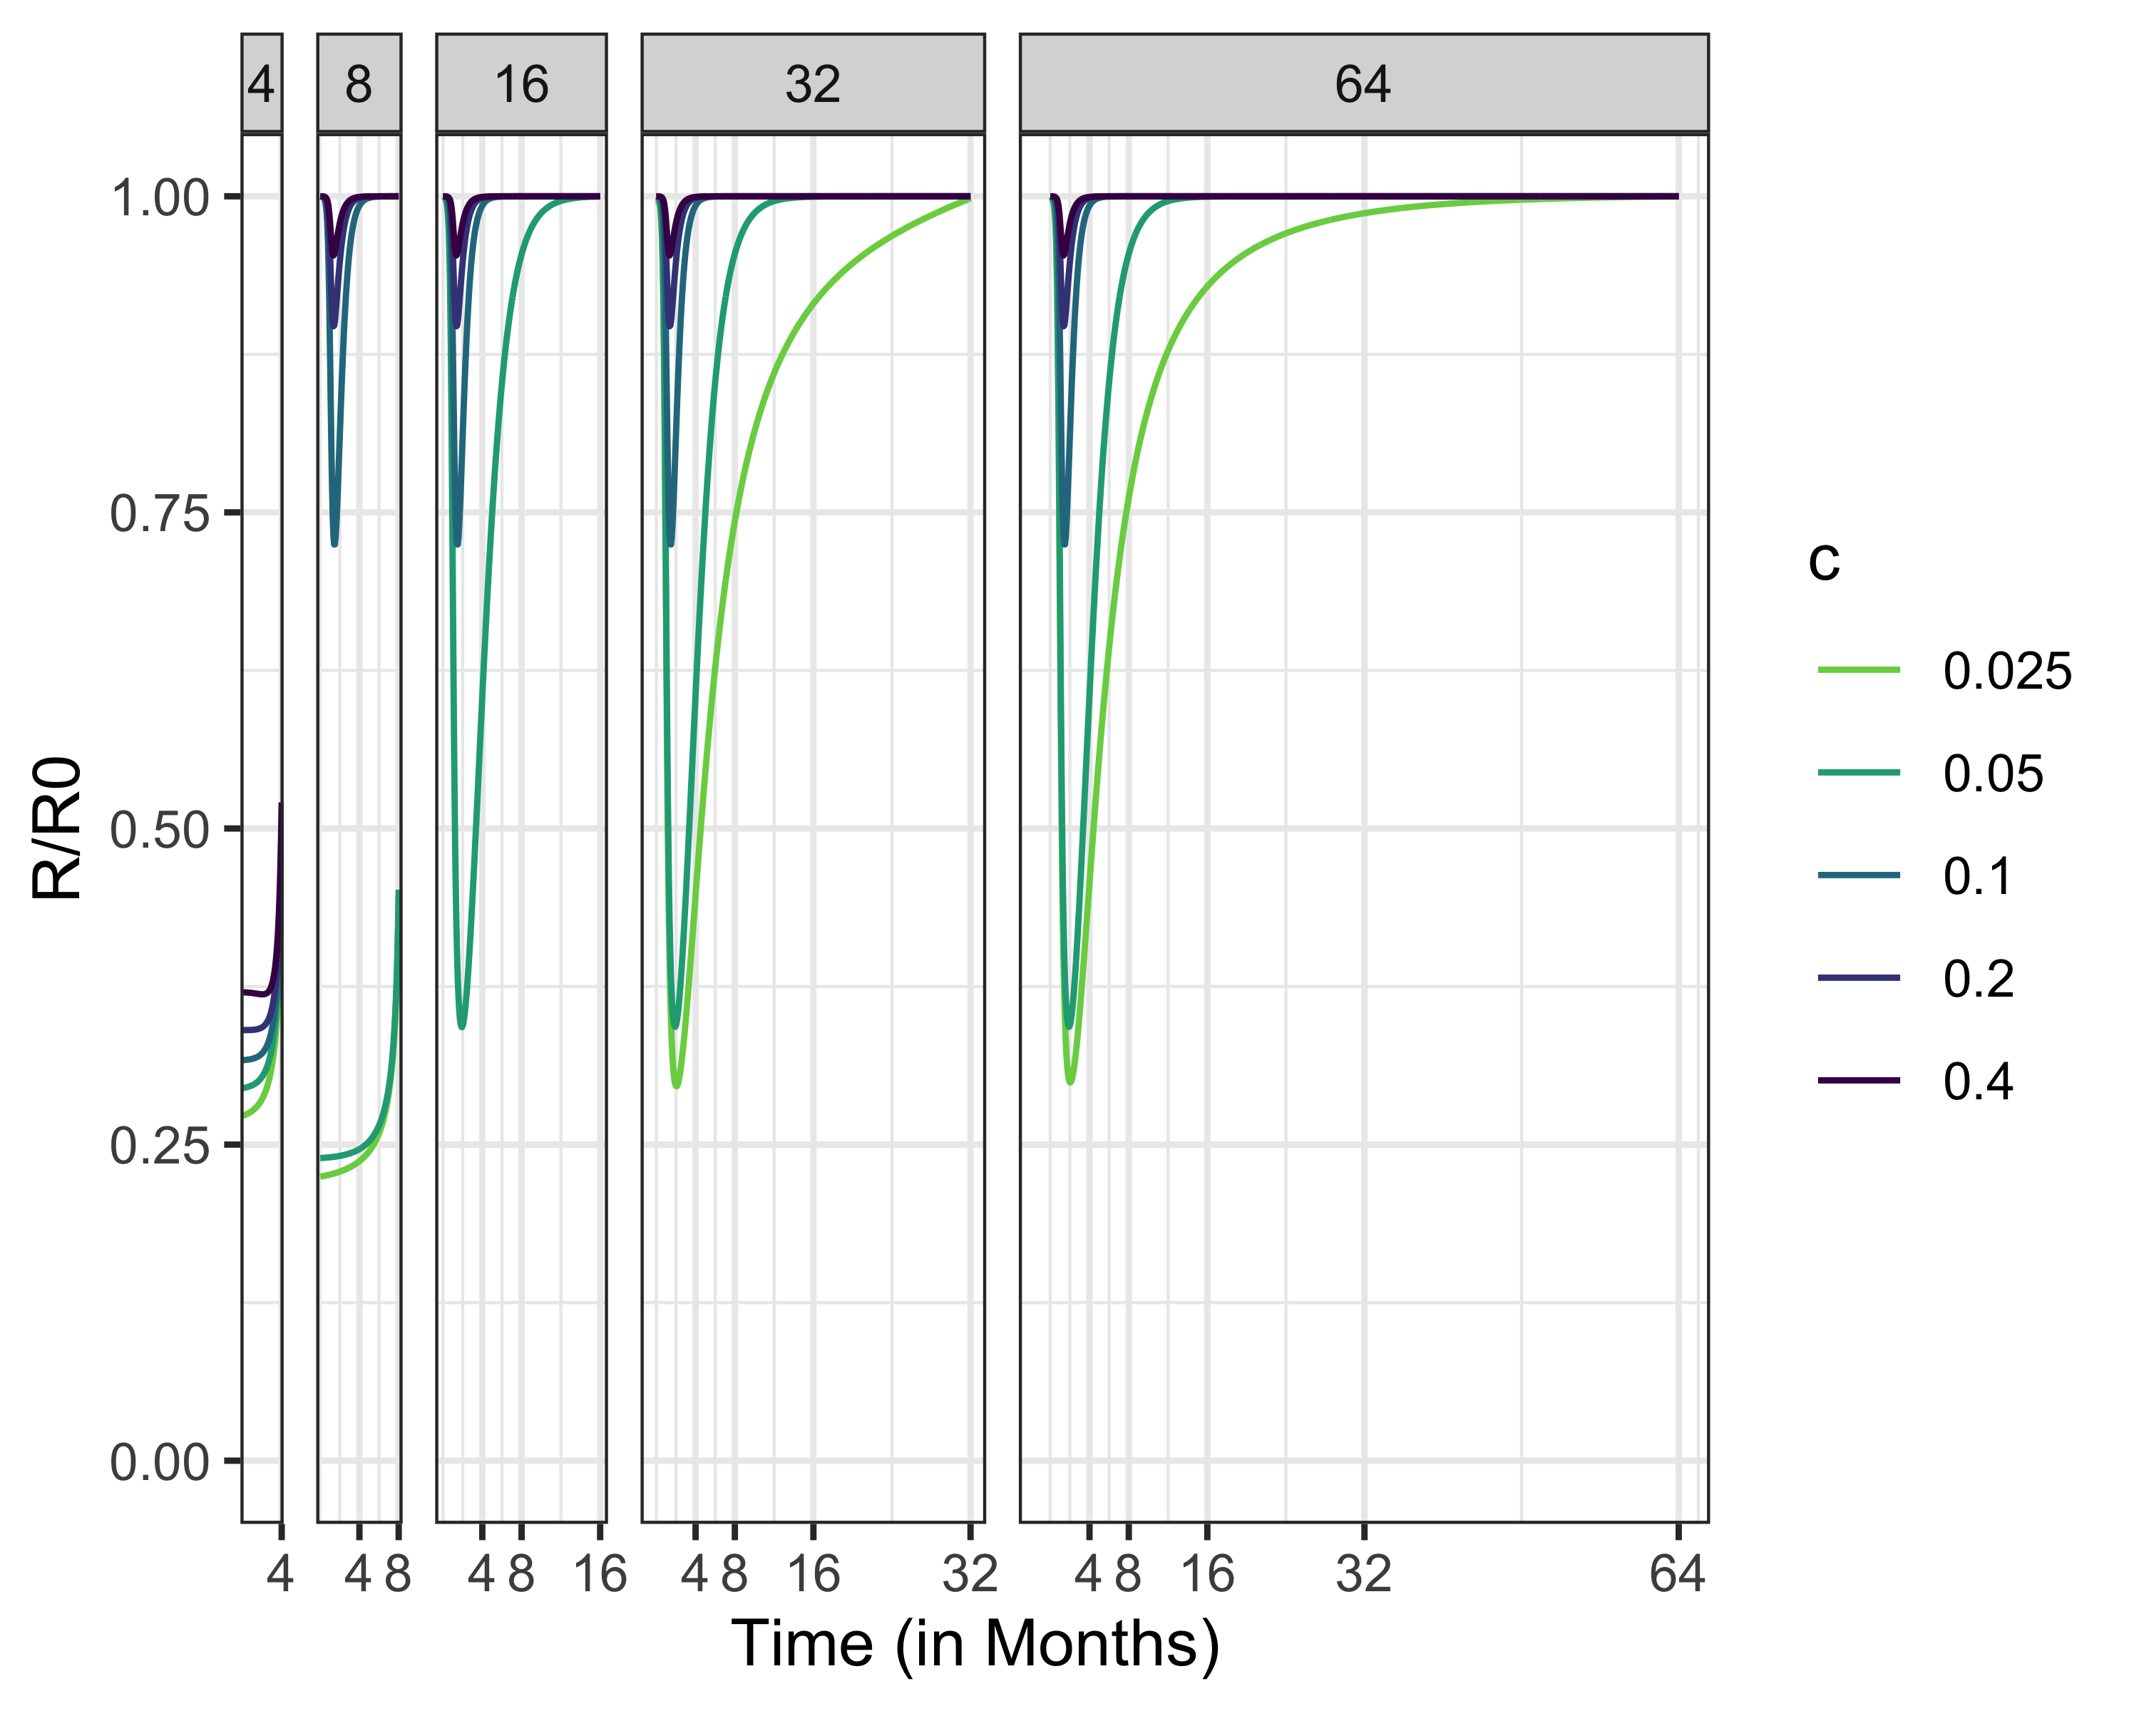
Social Distancing Policies, R0 = 5

Slide 39
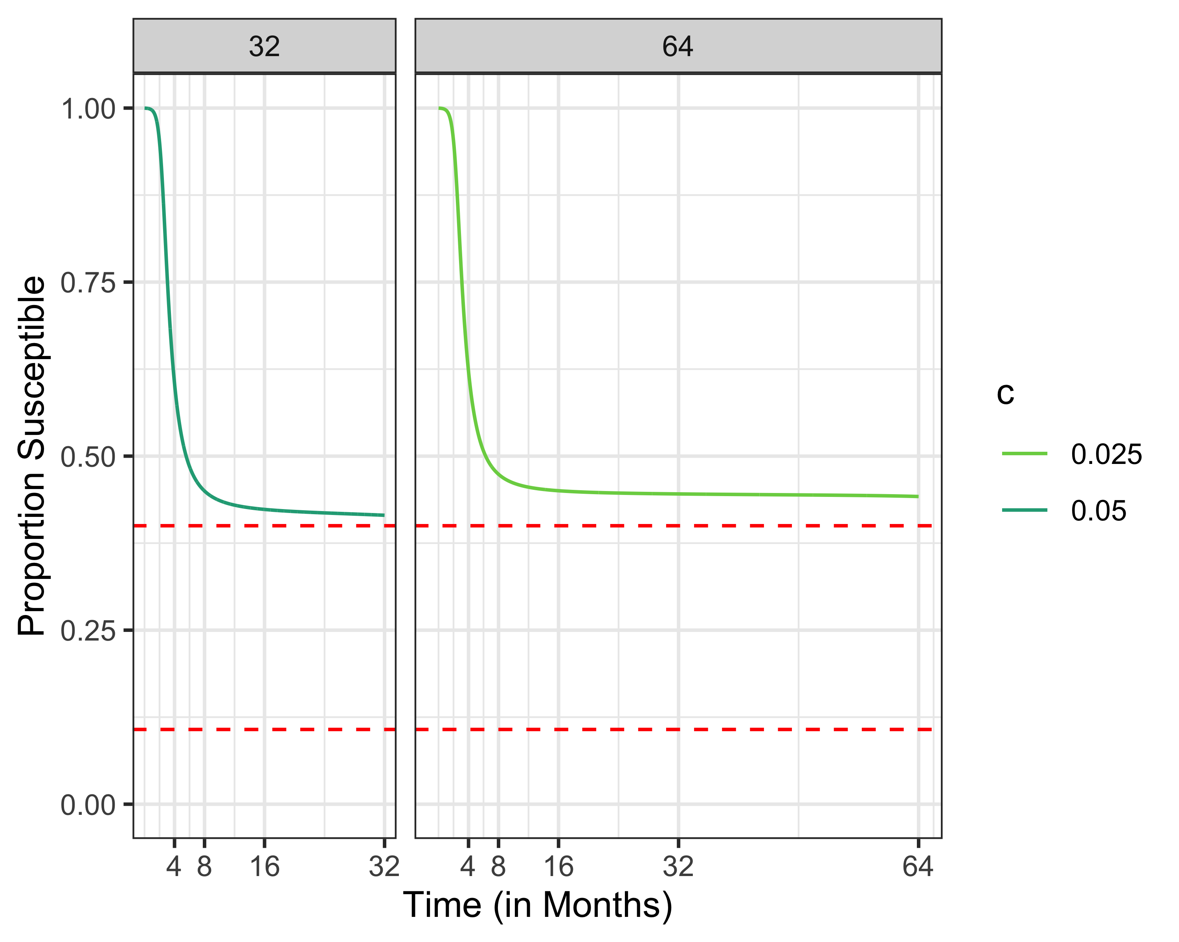
Intermediate Policies Between Mitigation and Suppression

Slide 40
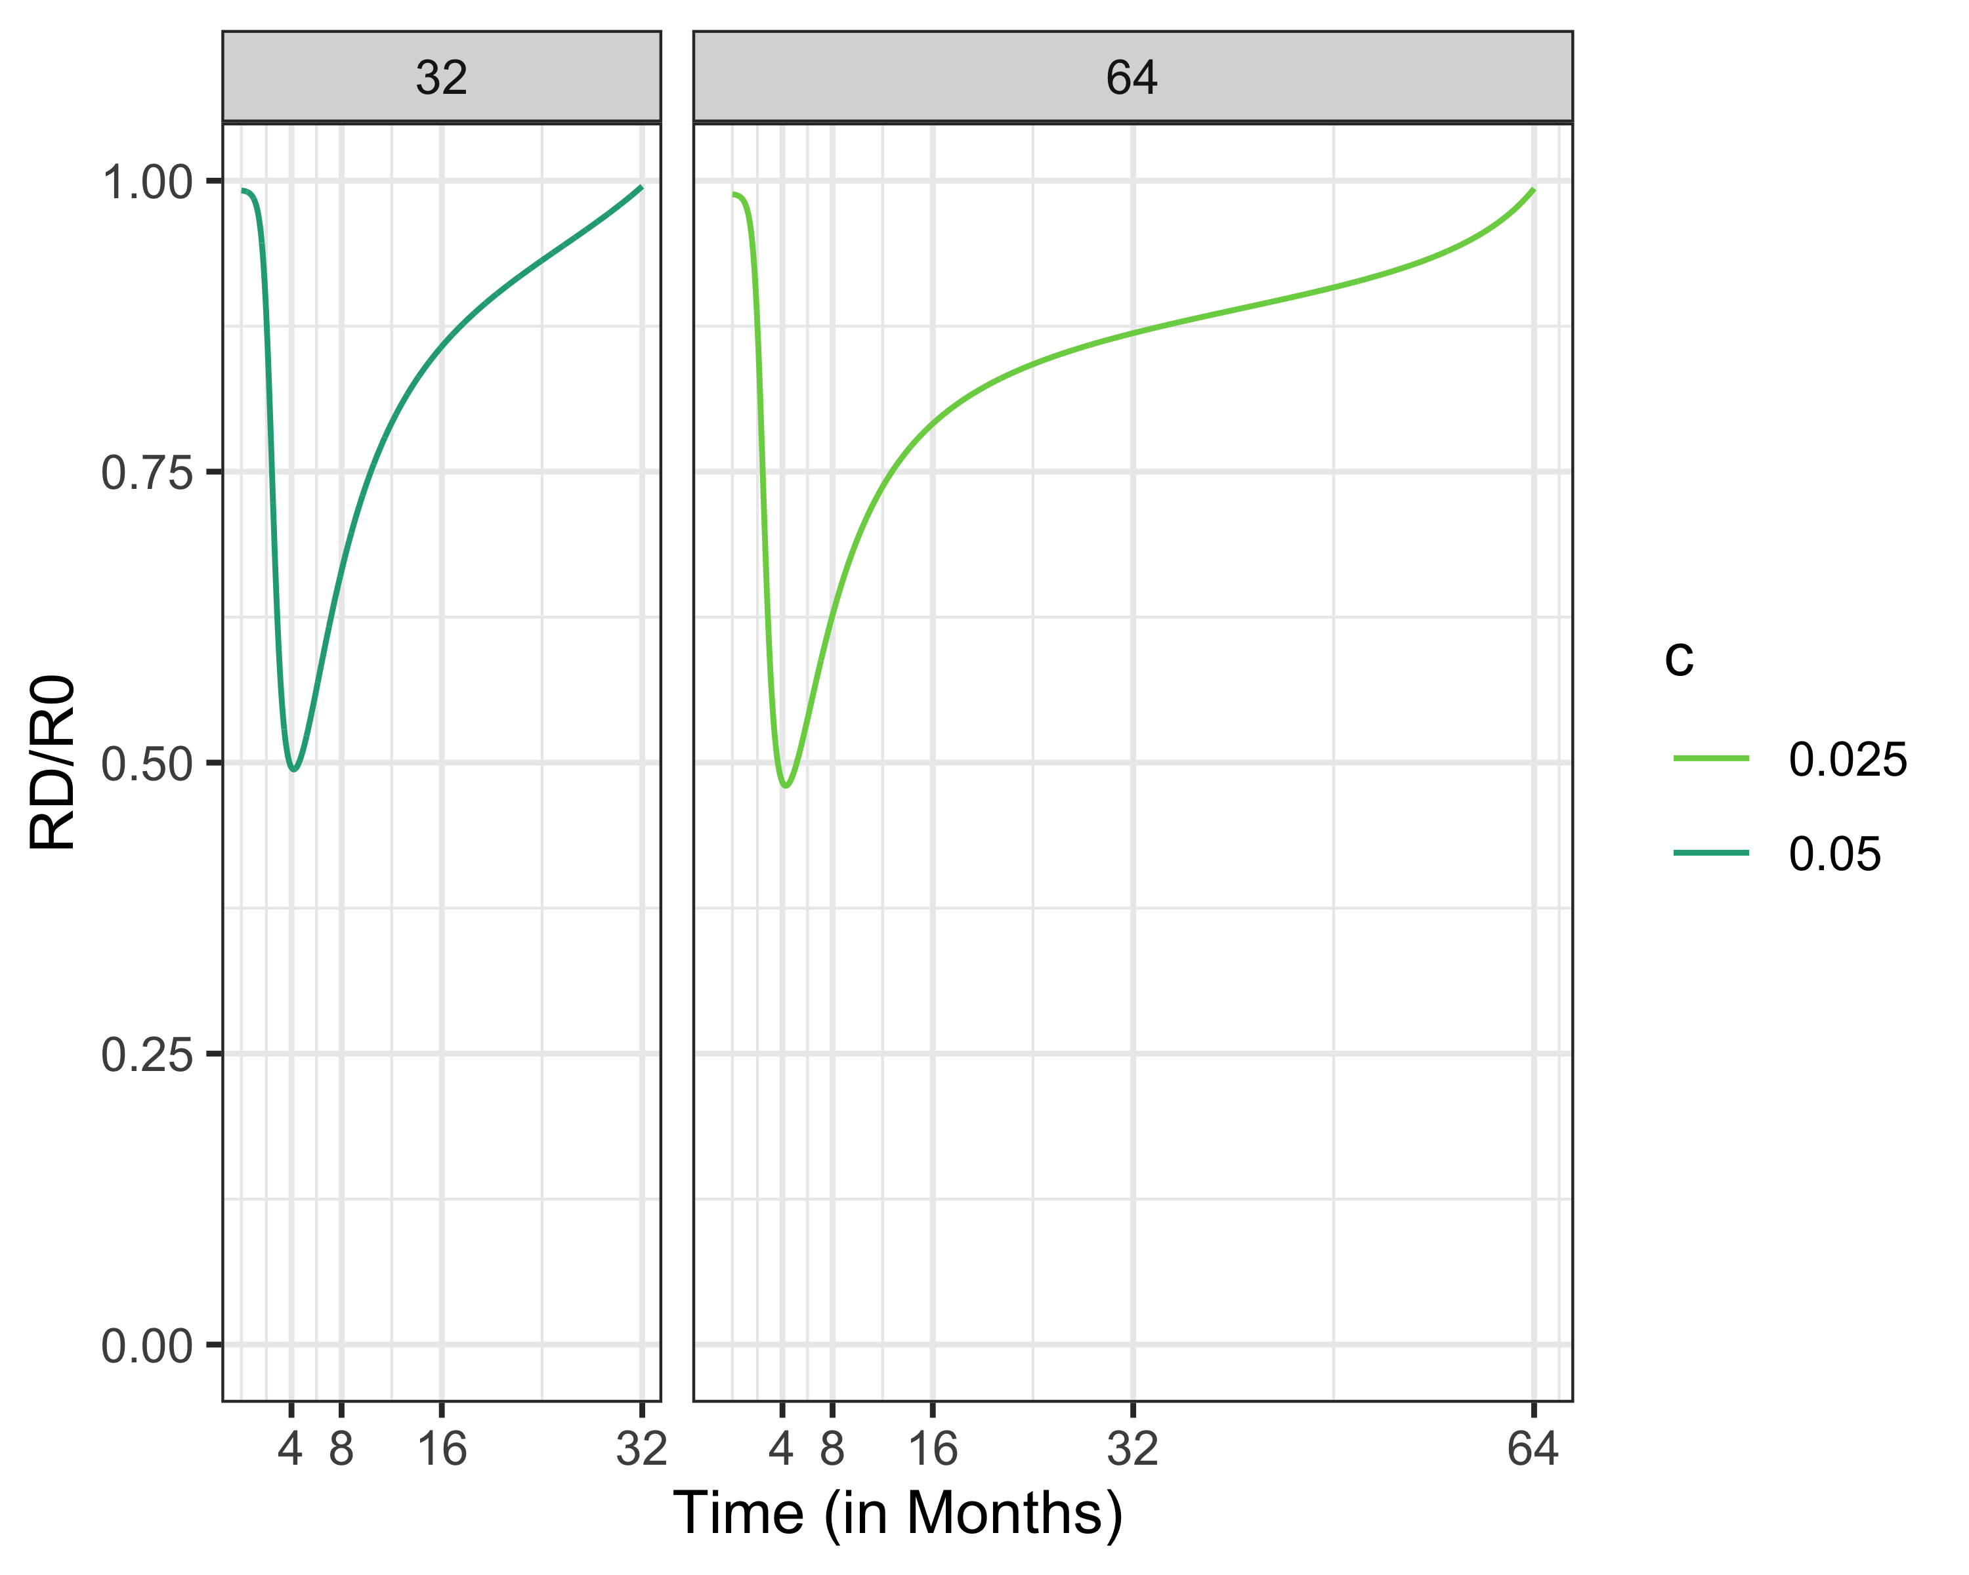
Intermediate Policies Between Mitigation and Suppression

Slide 41
What If Policy/Behavior Is Based On Current Risk Only?
Instead of considering what is best over the entire time period, weigh:
Risk of getting infected TODAY vs.
Cost of social distancing TODAY
This strategy ignores long-term control (i.e., benefit of social distancing if cases are low but rising)

Slide 42
Recall: Suppression Policies When Cost of Social Distancing Is Low

Slide 43
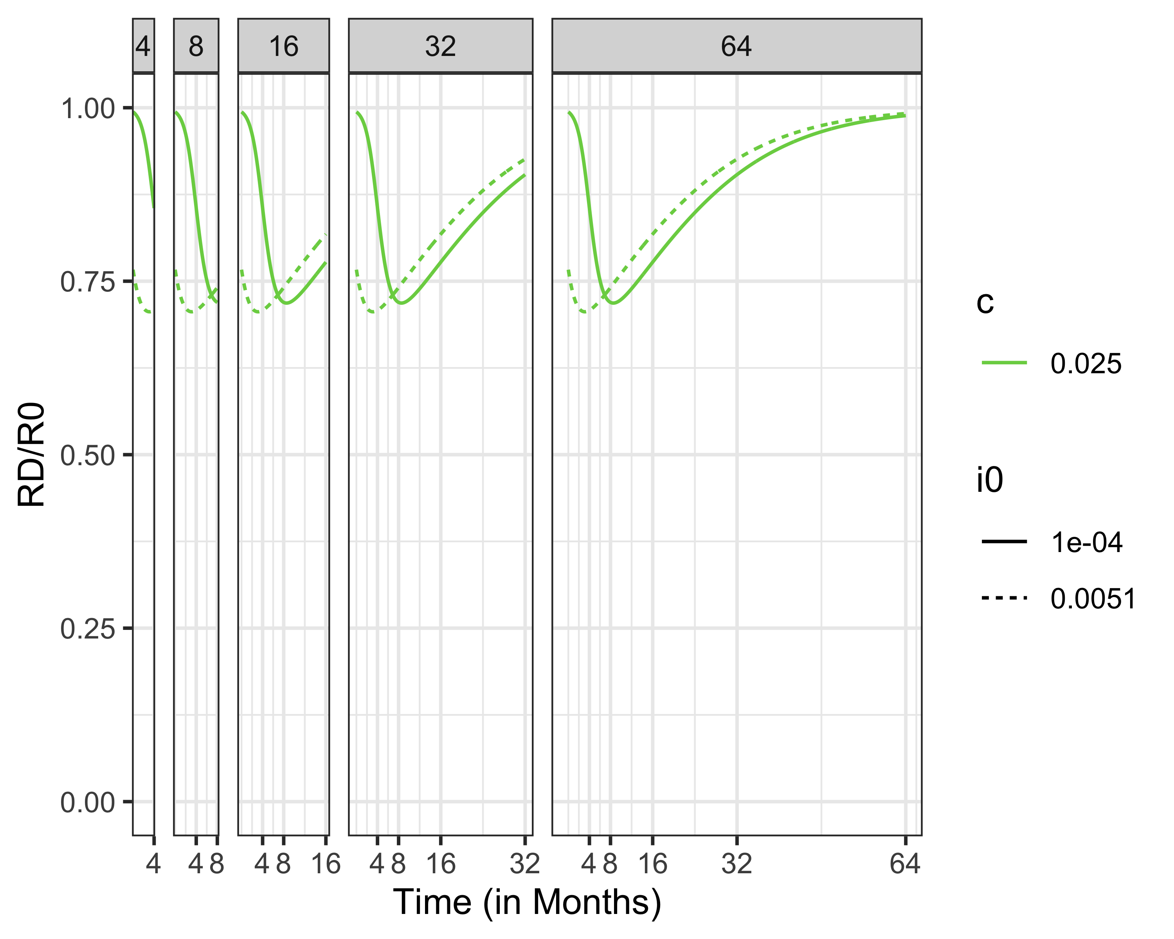
Policies Not Considering Long-Term Benefit of Social Distancing

Slide 44
Recall: Susceptibles When Considering Long-Term Benfits of Social Distancing

Slide 45
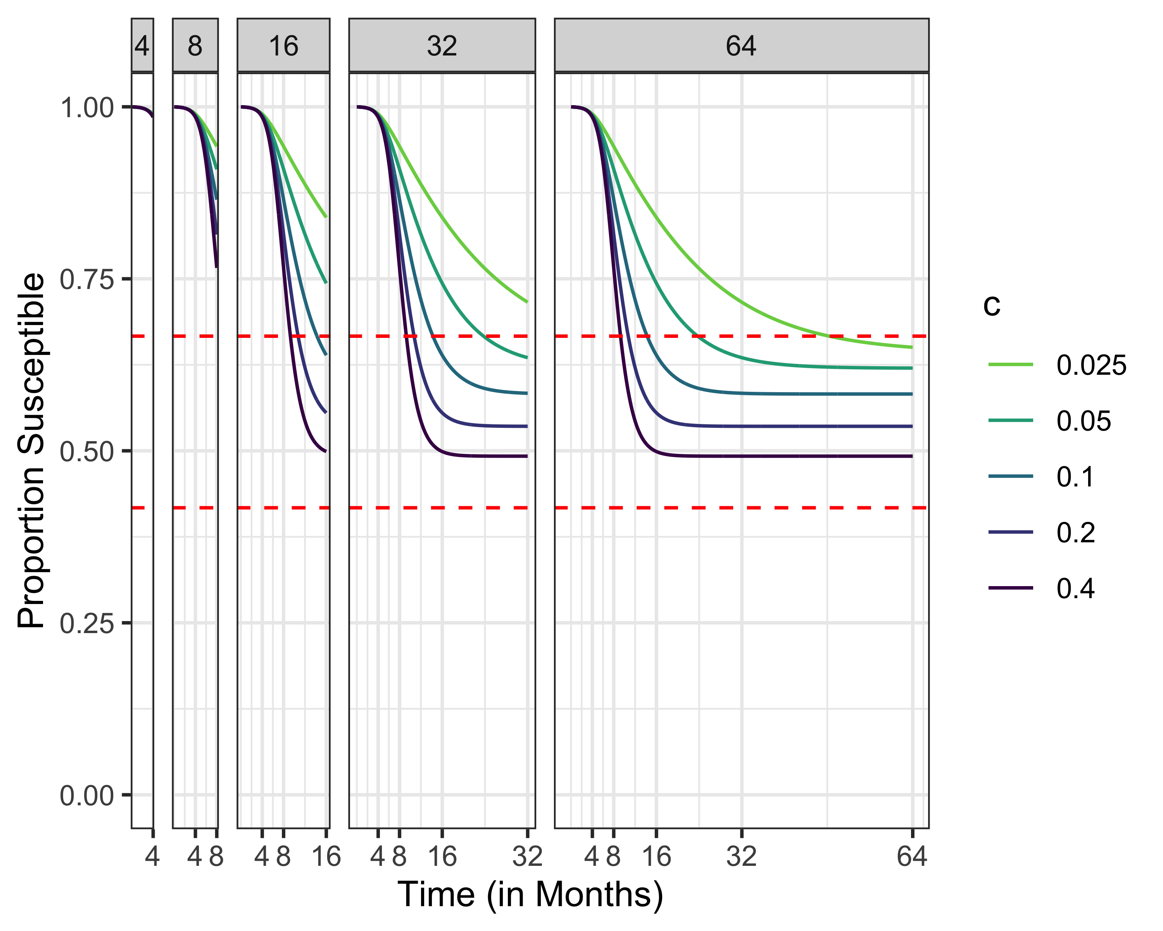
Policies When Considering Only Current Risk of Infection

Slide 47
(a)
(b)

Slide 48
Policies When Considering Only Current Risk of Infection

Slide 49
Policies When Considering Only Current Risk of Infection

Slide 50
Policies When Considering Only Current Risk of Infection

Slide 51
Policies When Considering Only Current Risk of Infection

Slide 52
Next Steps
Model can be generalized to consider:
SEIR, SIRS, SEIRS
Multiple population groups (low-risk, high risk)
Birth/death processes
Requires solving an 2pt boundary value problem “easy”

Slide 53
Acknowledgements
Raffaele Vardavas, PhD
Pedro Lima

